Slide 1
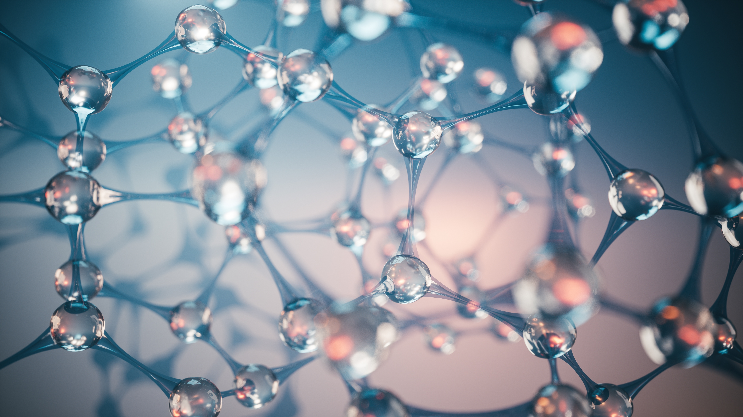
What are Biomaterials?

Slide 2
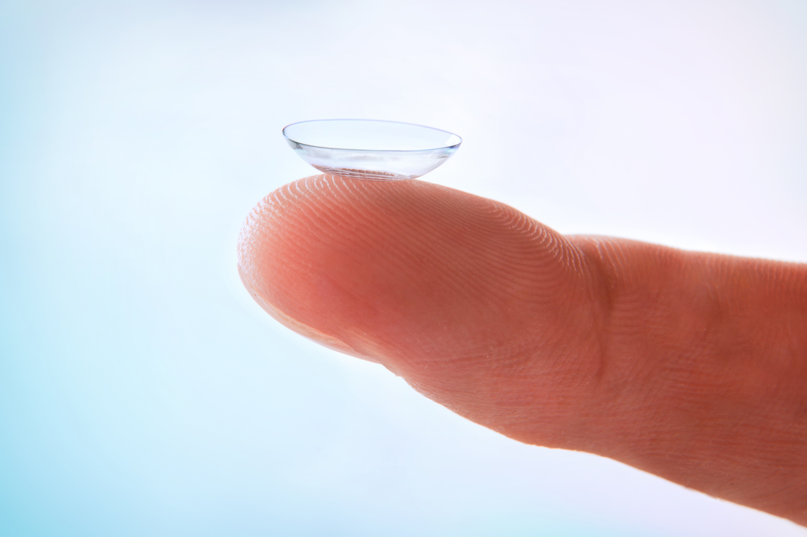
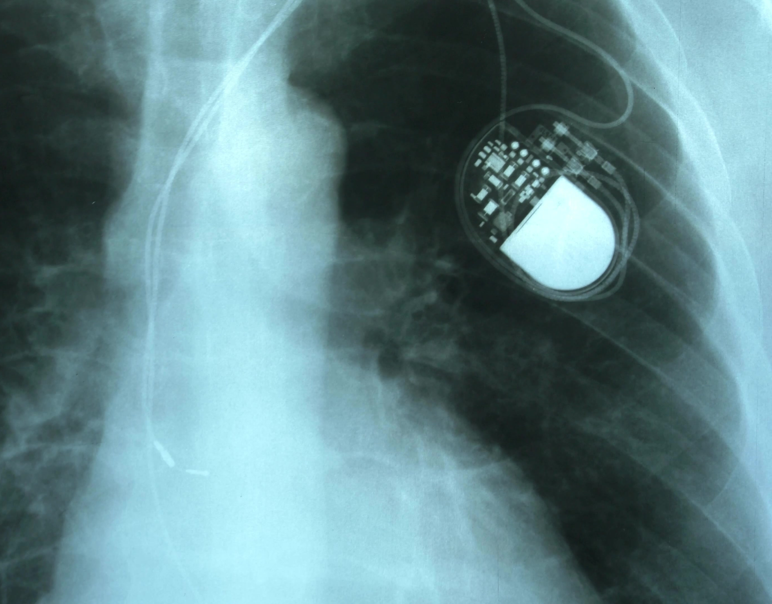
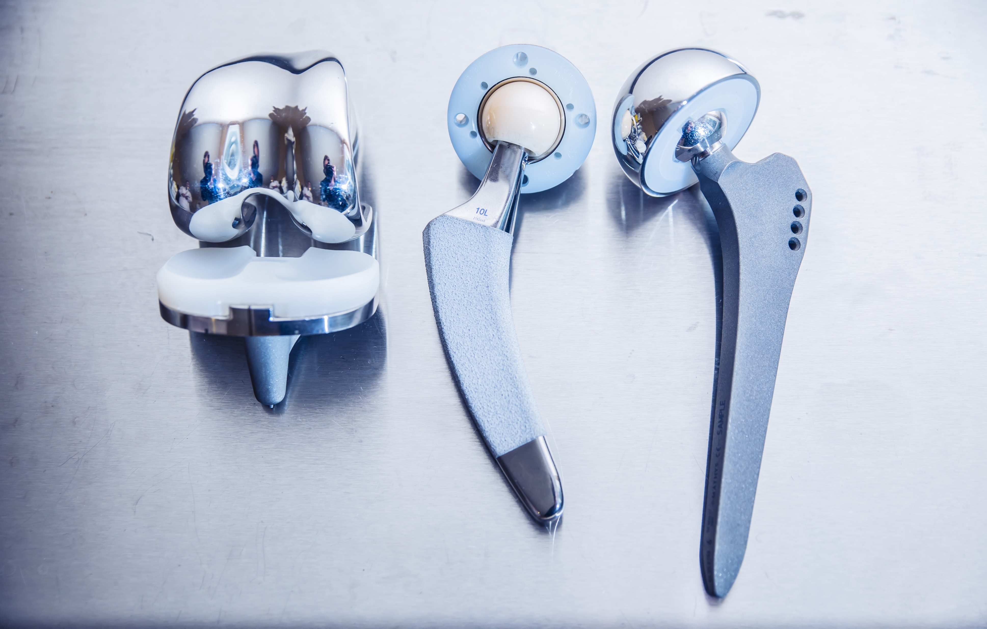
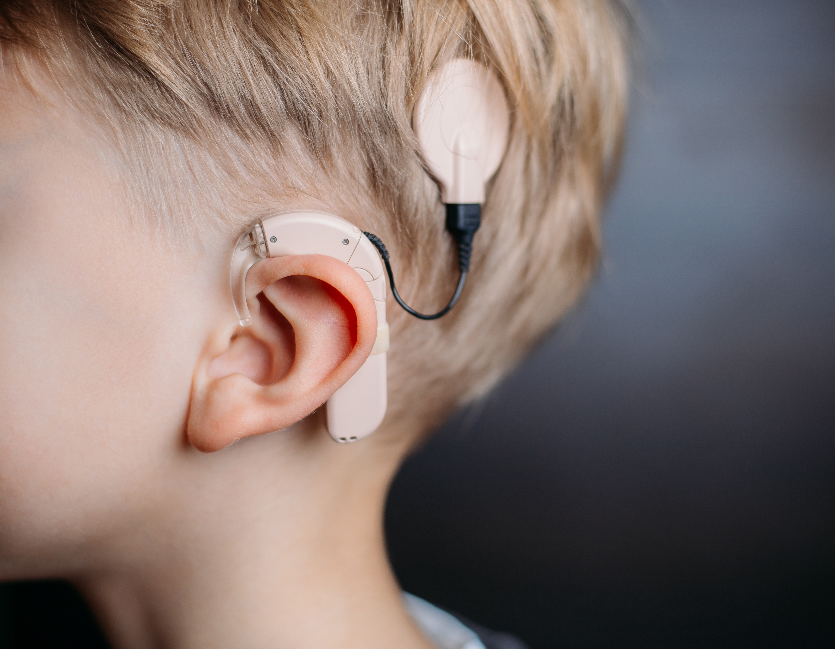
Biomaterials:
A synthetic or natural material that is used in a medical device and intended to interact with biological systems.

Slide 3
Synthetic vs Natural
Synthetic: materials made through chemical reactions, producing a material with new properties (stainless steel, titanium, etc.)
Natural: materials found in nature/biologically derived (silk, collagen, gelatin, etc.)
Combination: material made of both synthetic and natural materials

Slide 4
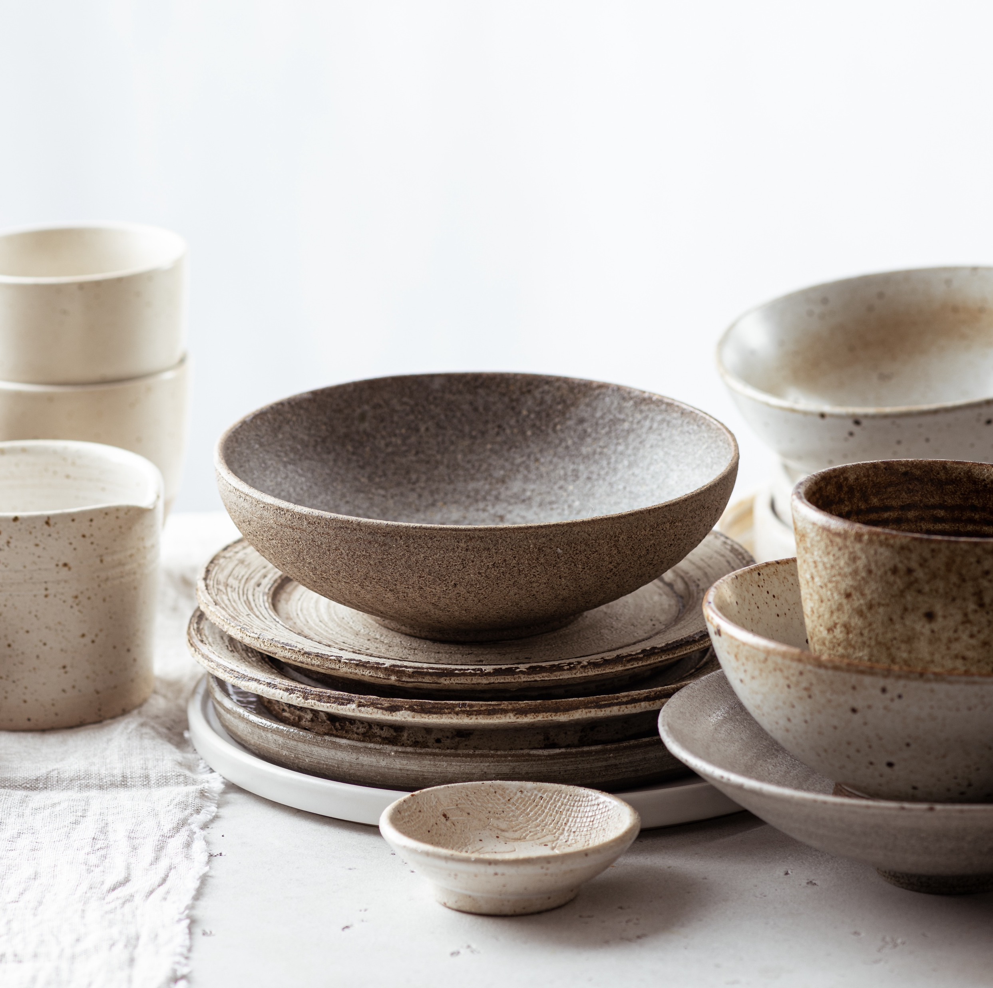
Ceramics
Ceramics: A hard material made from naturally occurring, but non-metallic raw materials (clay, sand, etc.)
Medical Applications:
Bone grafts, bone cements, implant coatings, etc.
Synthetic or natural:
Can be synthetic or natural, or a combination of both
Source: Britannica Kids

Slide 5
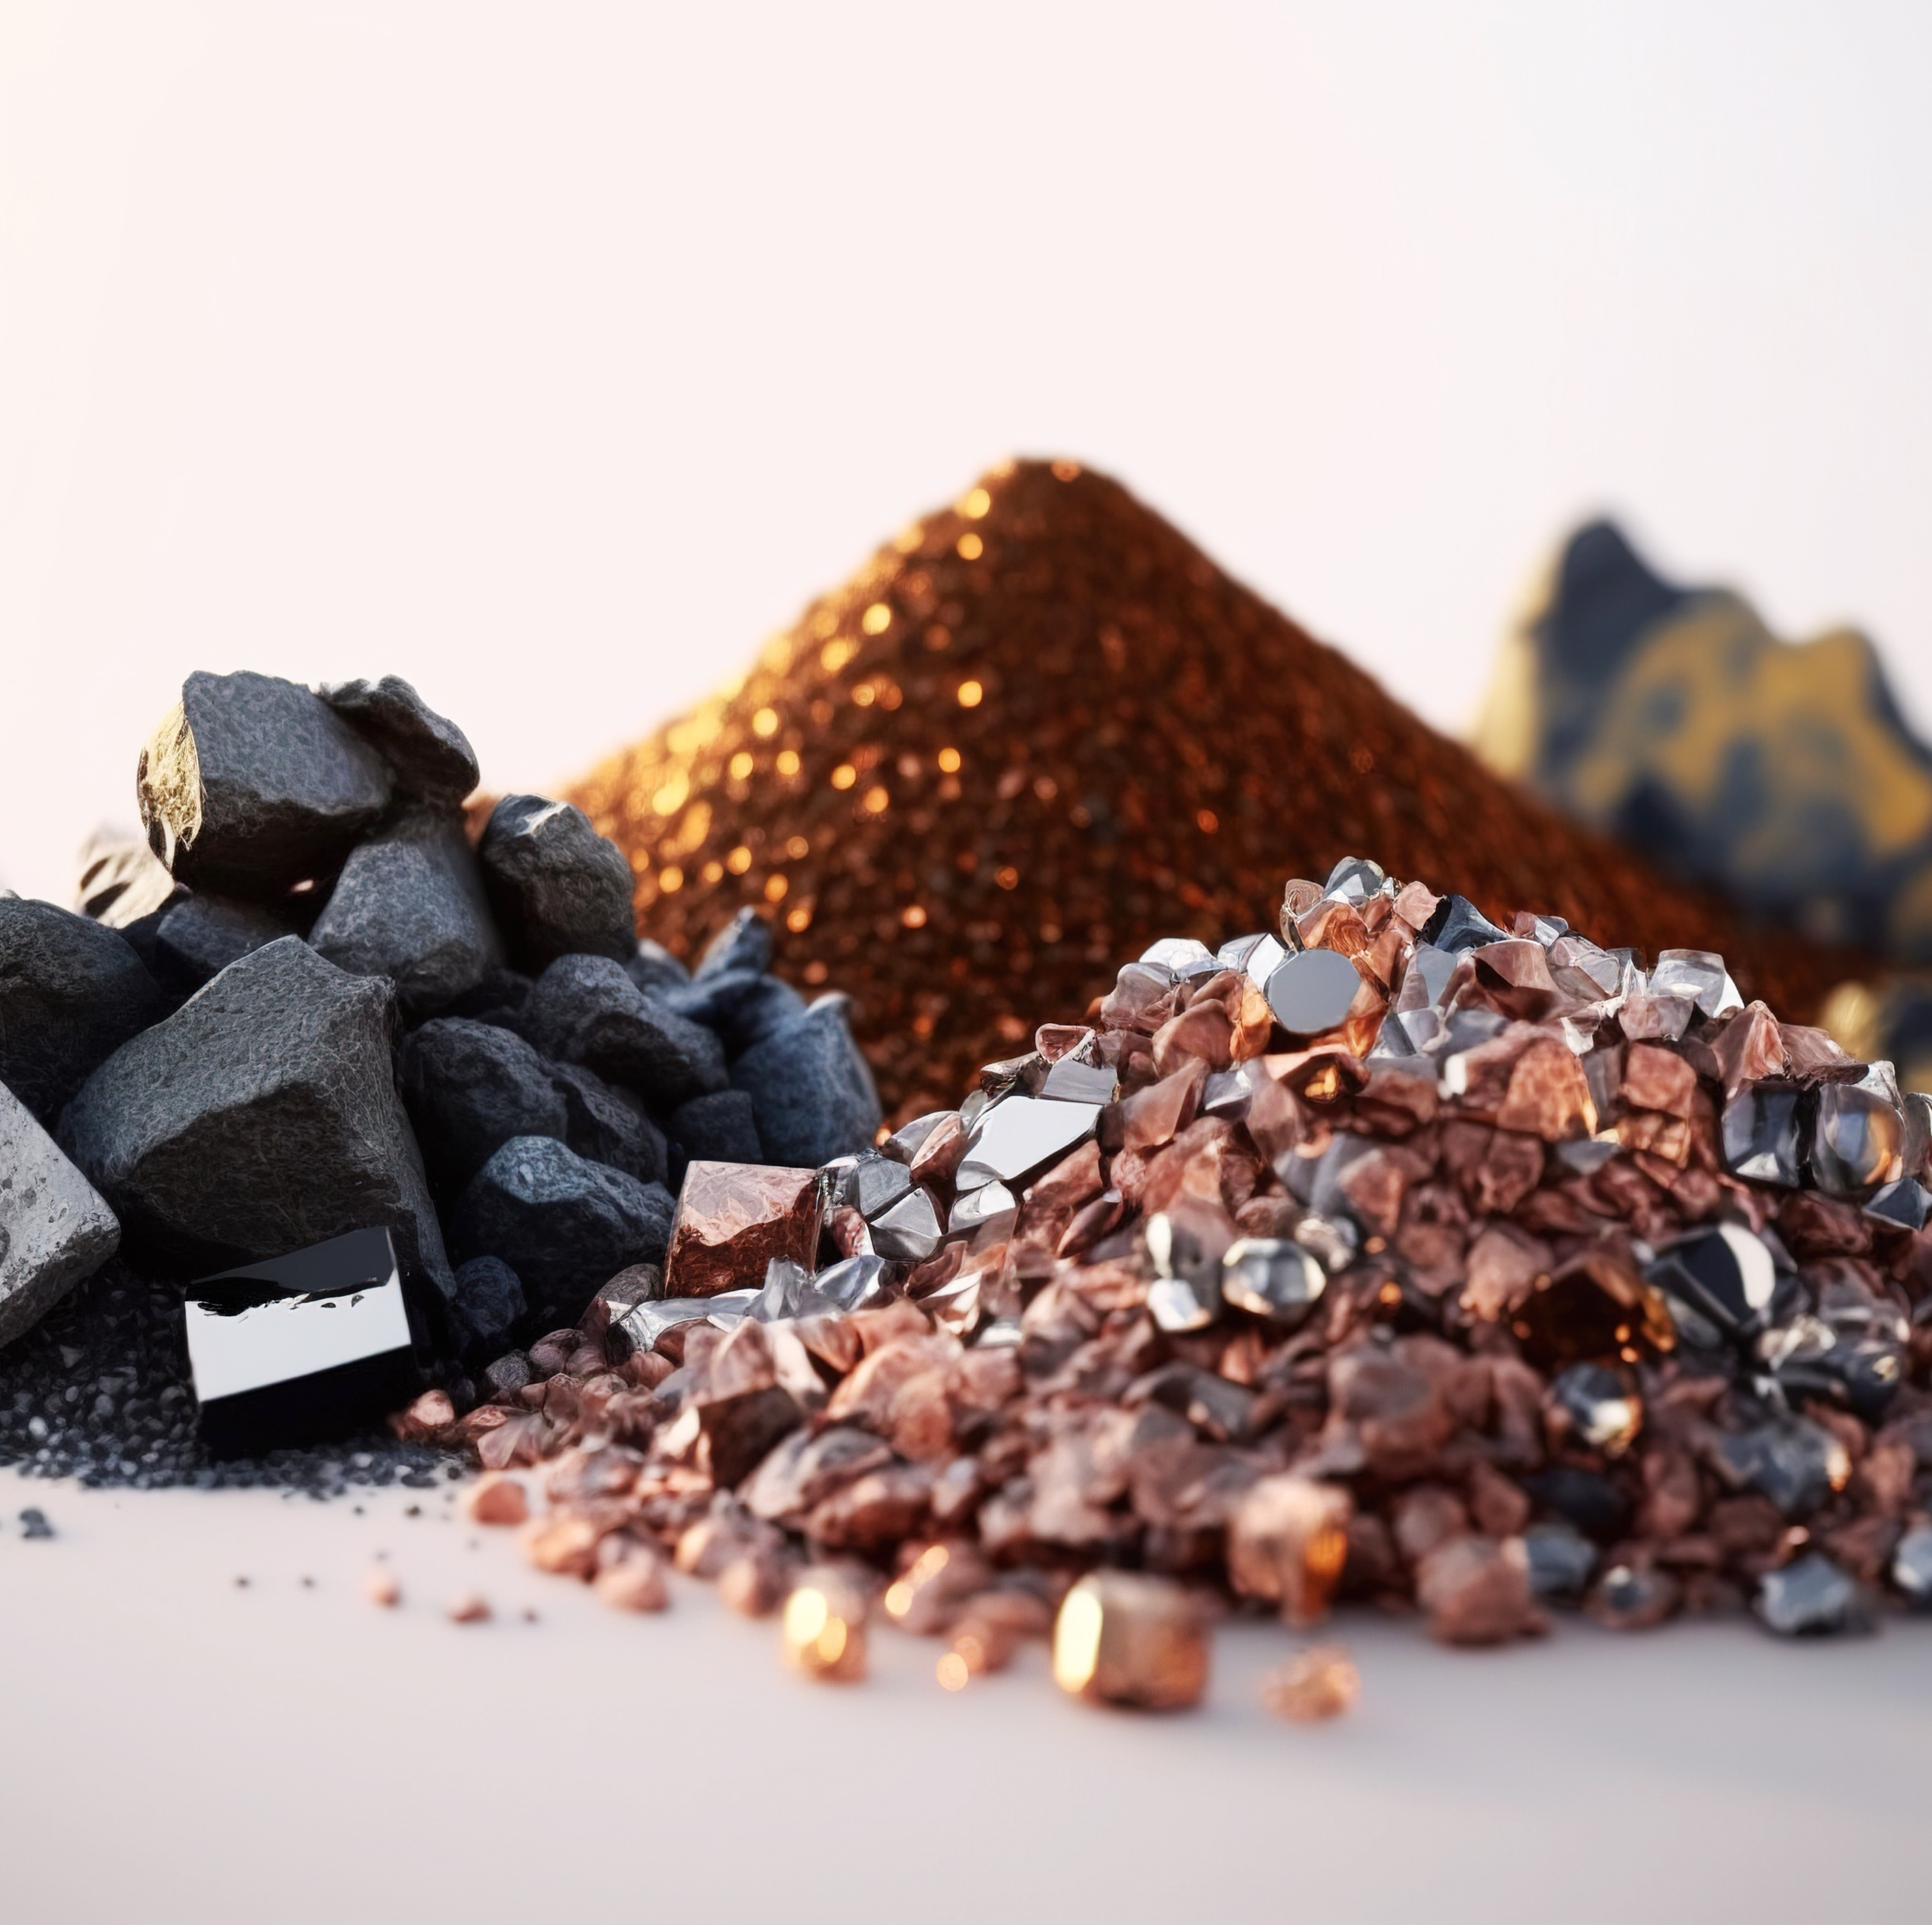
Metals
Definition: “A substance characterized by its strength and ability to conduct heat and electricity”
Medical Applications: Electrodes for electronic devices, orthopedic fixation plates and screws, etc.
Natural or Synthetic:
Can be synthetic or natural
Source: Mining and Refining
Source: Britannica Kids

Slide 6
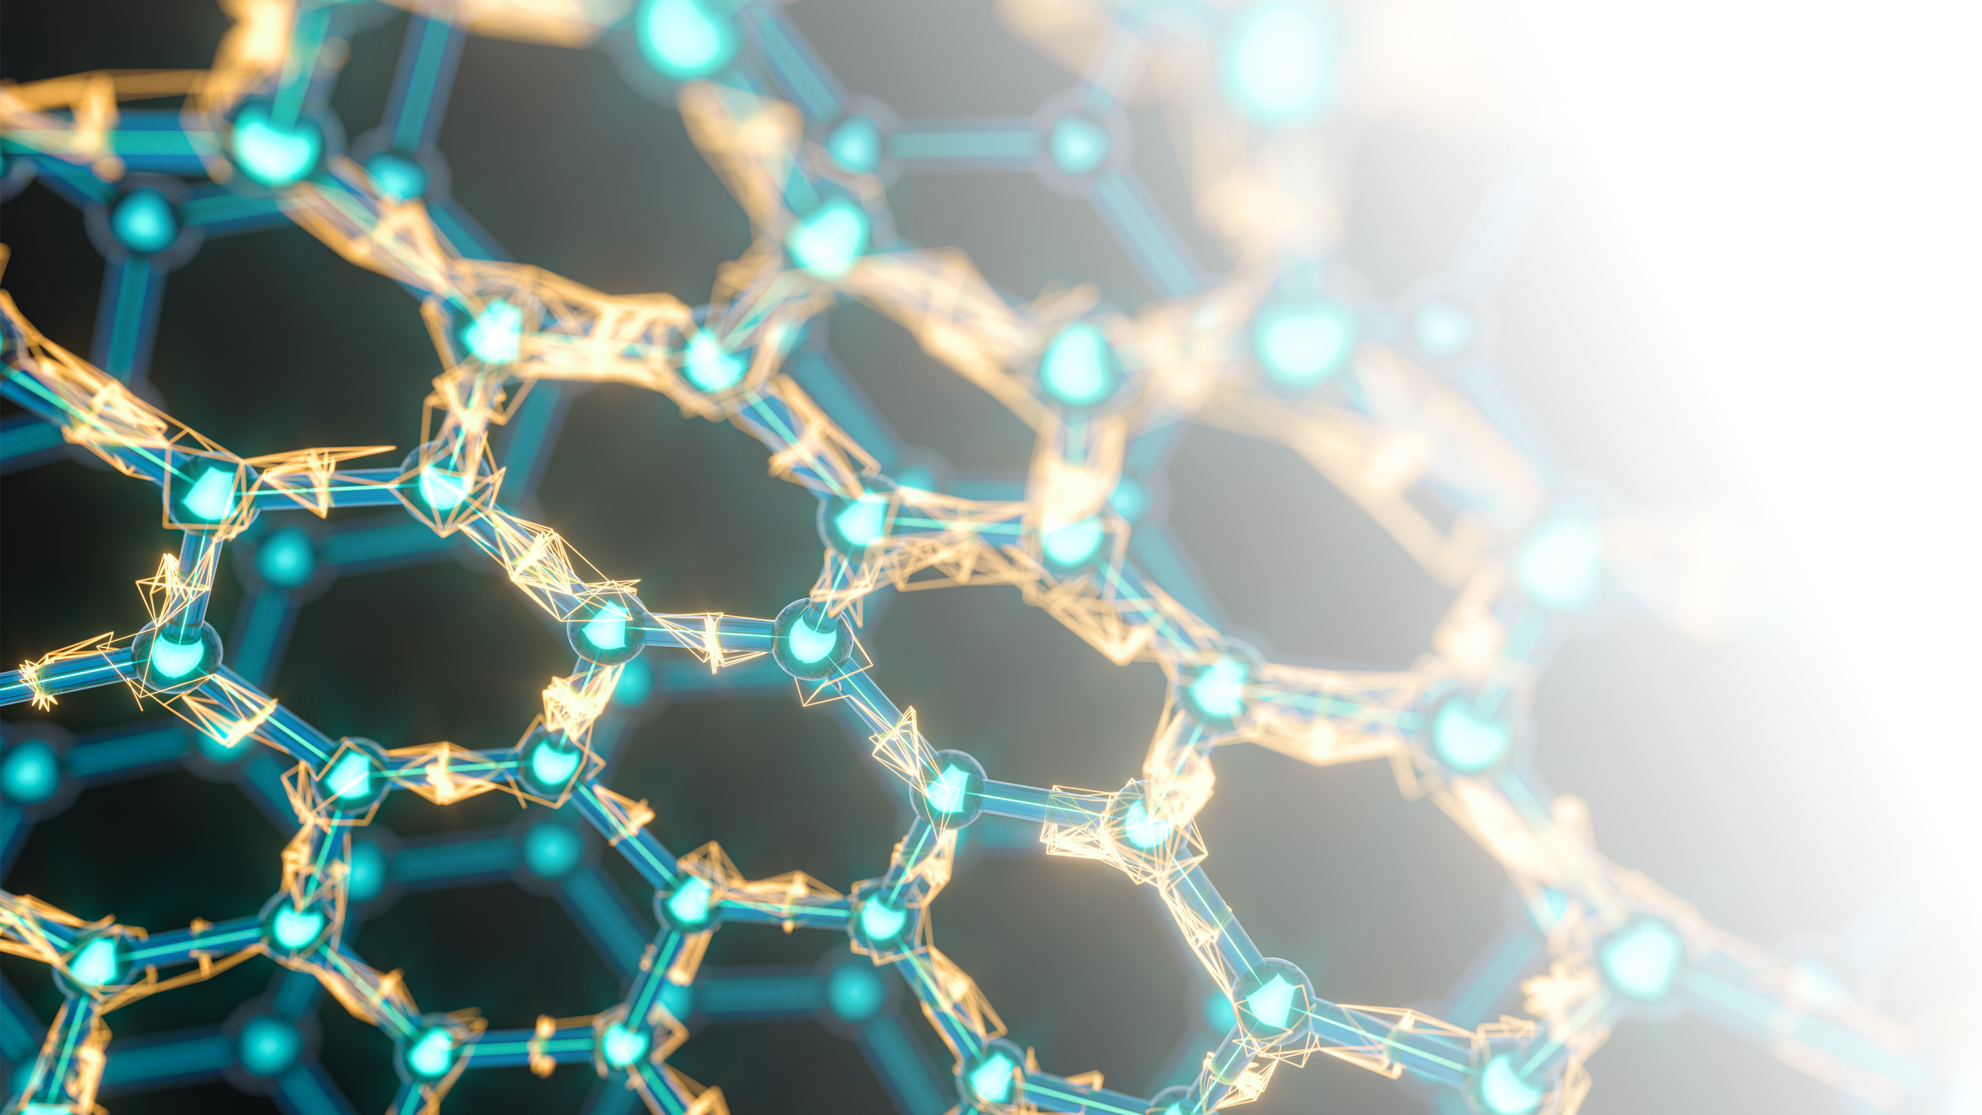
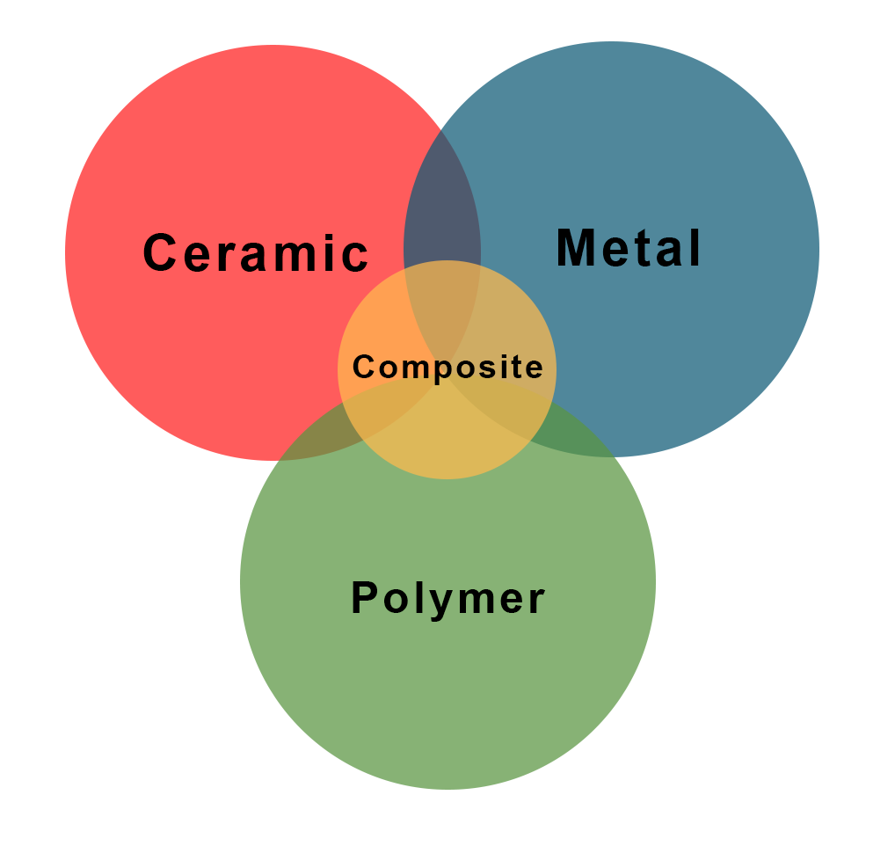
What are the three major types of biomaterials?

Slide 7
Polymers
Definition: Large molecules made from small repeating units.
  Poly = many
  Mer = the repeating units within a polymer
Medical Applications: Contact lenses, knuckle replacements, sutures
Source: Synthetic polymers are derived from petroleum oil
How are they made: synthetic polymers are created through chemical reactions
Synthetic or natural: Can be synthetic or natural, or a combination
Hydrogels: A type of polymer that swells in water and retains water within the structure without dissolving (used for soft tissue applications such as contract lenses)

Slide 8
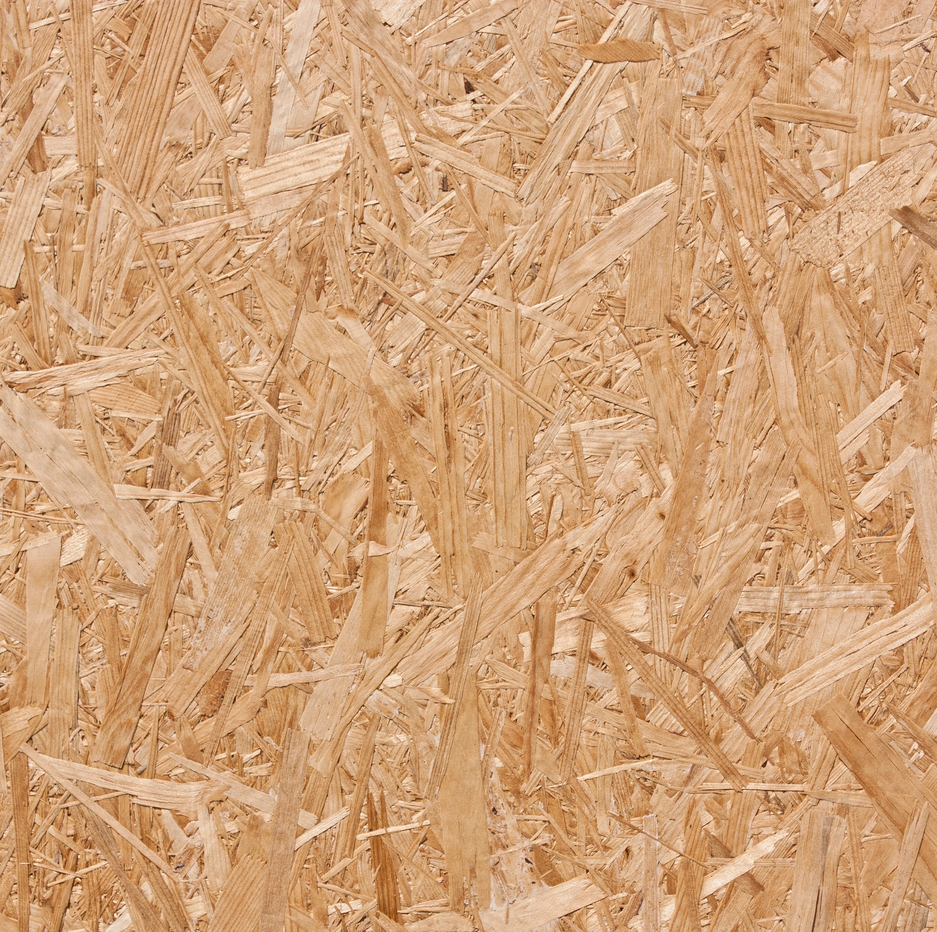
Composites
Definition: Substances consisting of two or more distinct materials (metals, polymers, ceramics, etc.)
Why use composites? Used to improve material properties and often to optimize mechanical properties.
Medical Applications: Dental implants or orthopedics
Synthetic or natural: Can be synthetic, natural or a combination

Slide 9
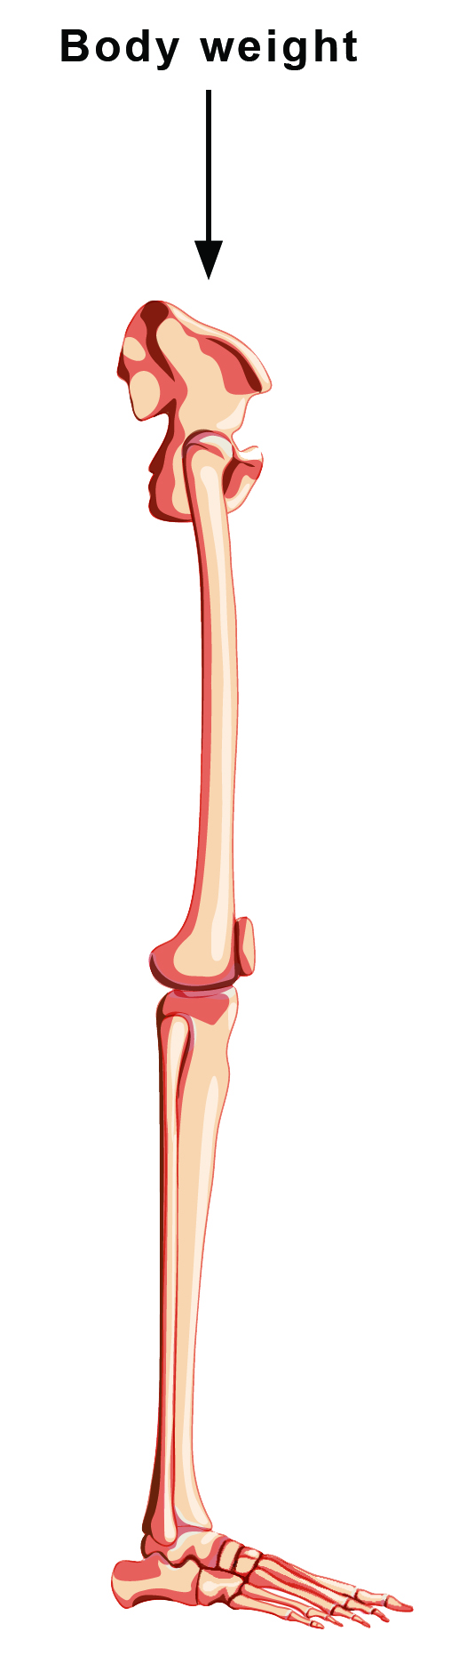
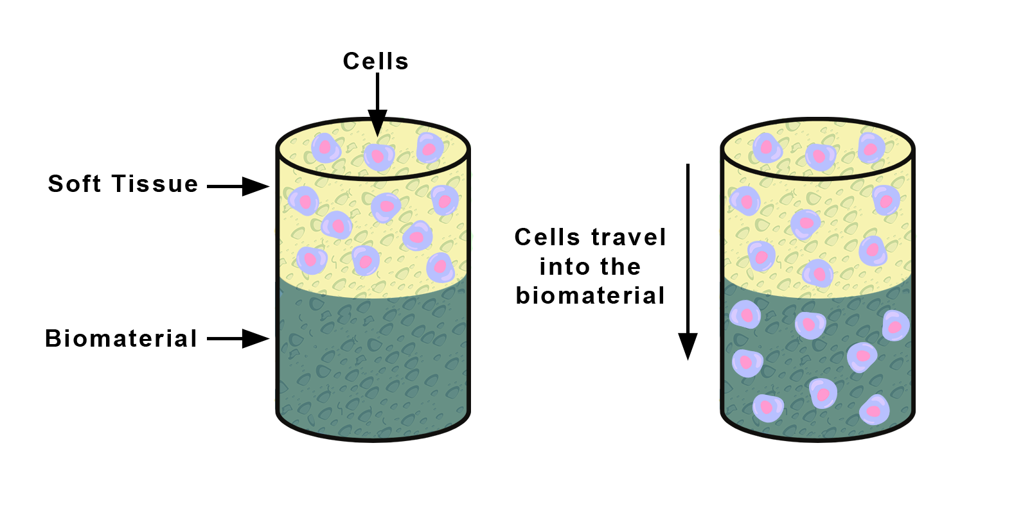
Material Properties
Materials are often chosen for a medical application based on their properties
Examples:
  Load bearing bone/joint → need a material that can withstand the loading forces
  Soft tissue → need a soft material that can be infiltrated by cells

Slide 10
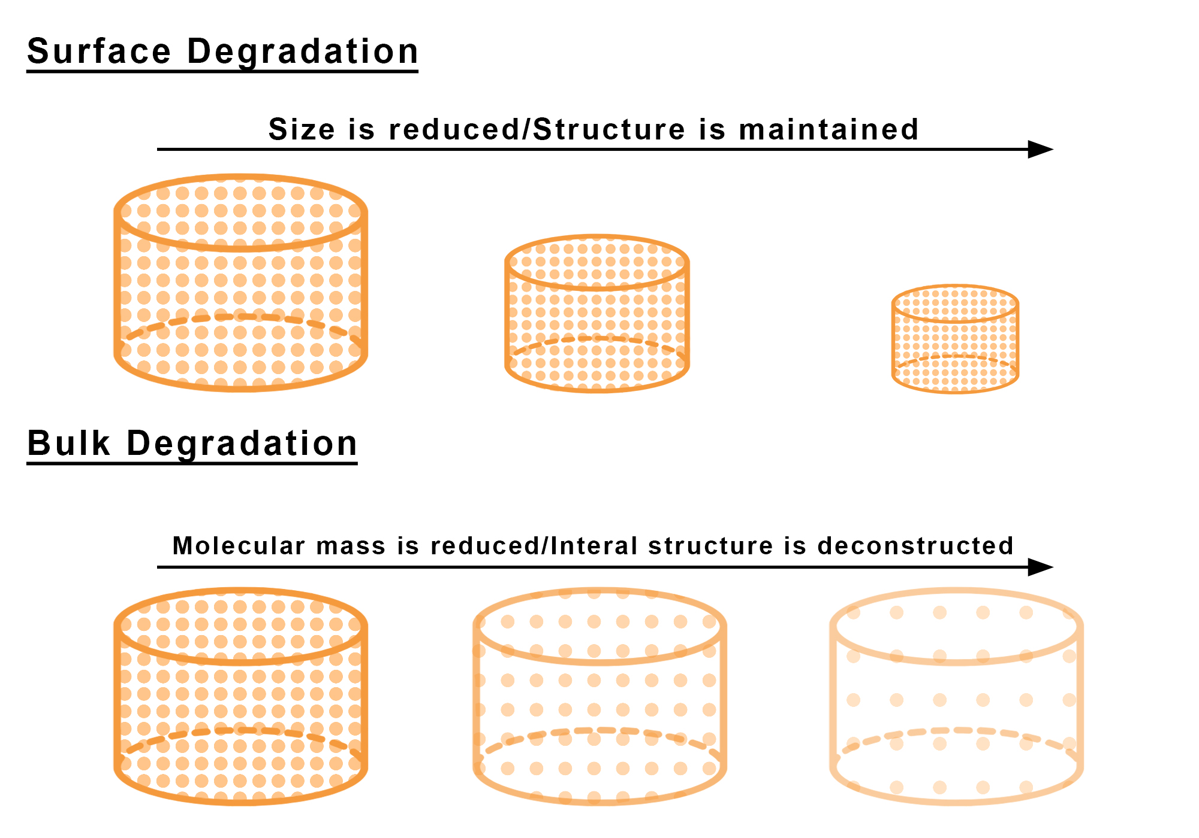
Material Properties – Degradation
Biodegradable: controlled loss of material (degradation) within the body following implantation/administration of the biomaterial.
  Example: Controlled drug release
Biomaterials for tissue engineering aim to support tissue growth → new tissue forms while materials degrades

Slide 11
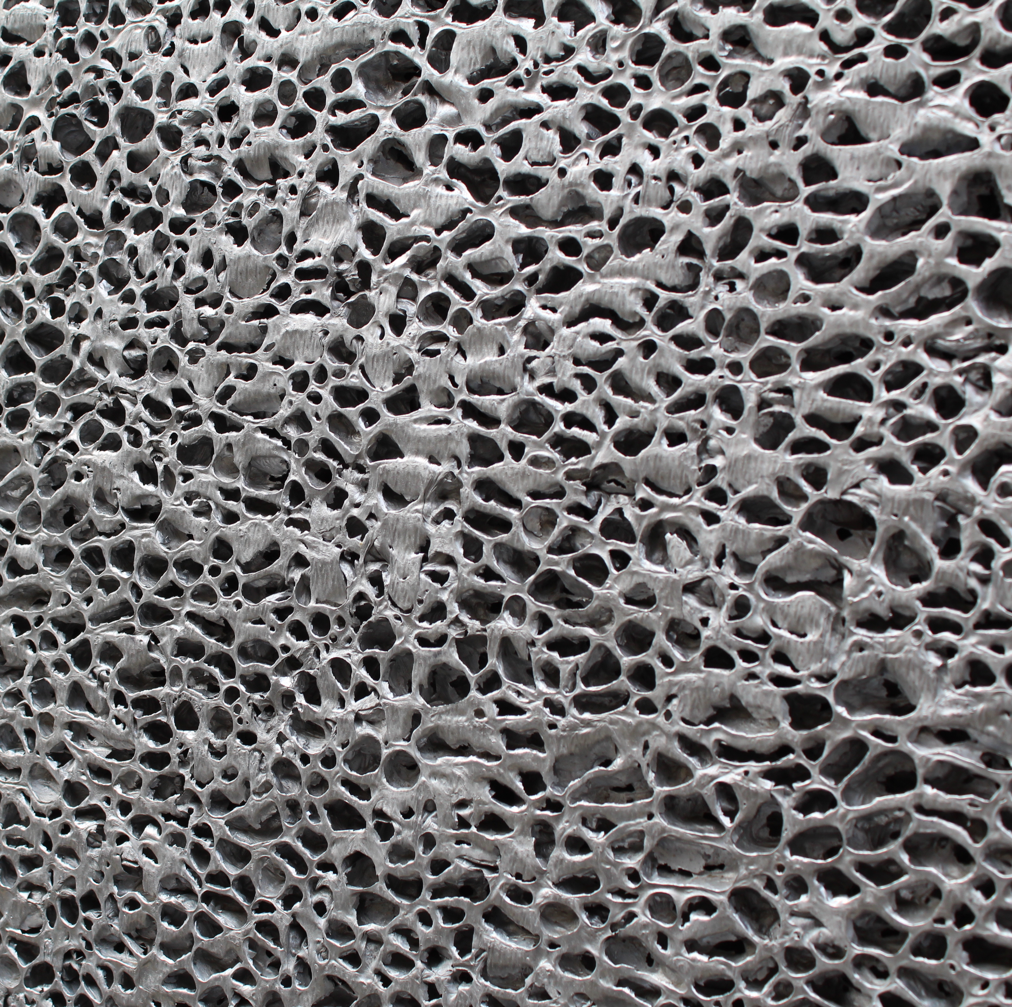
Material Properties – Porosity
Porosity: Percentage of added holes/spaces throughout a material
Porosity affects mechanical properties and promotes favorable tissue responses.

Slide 12
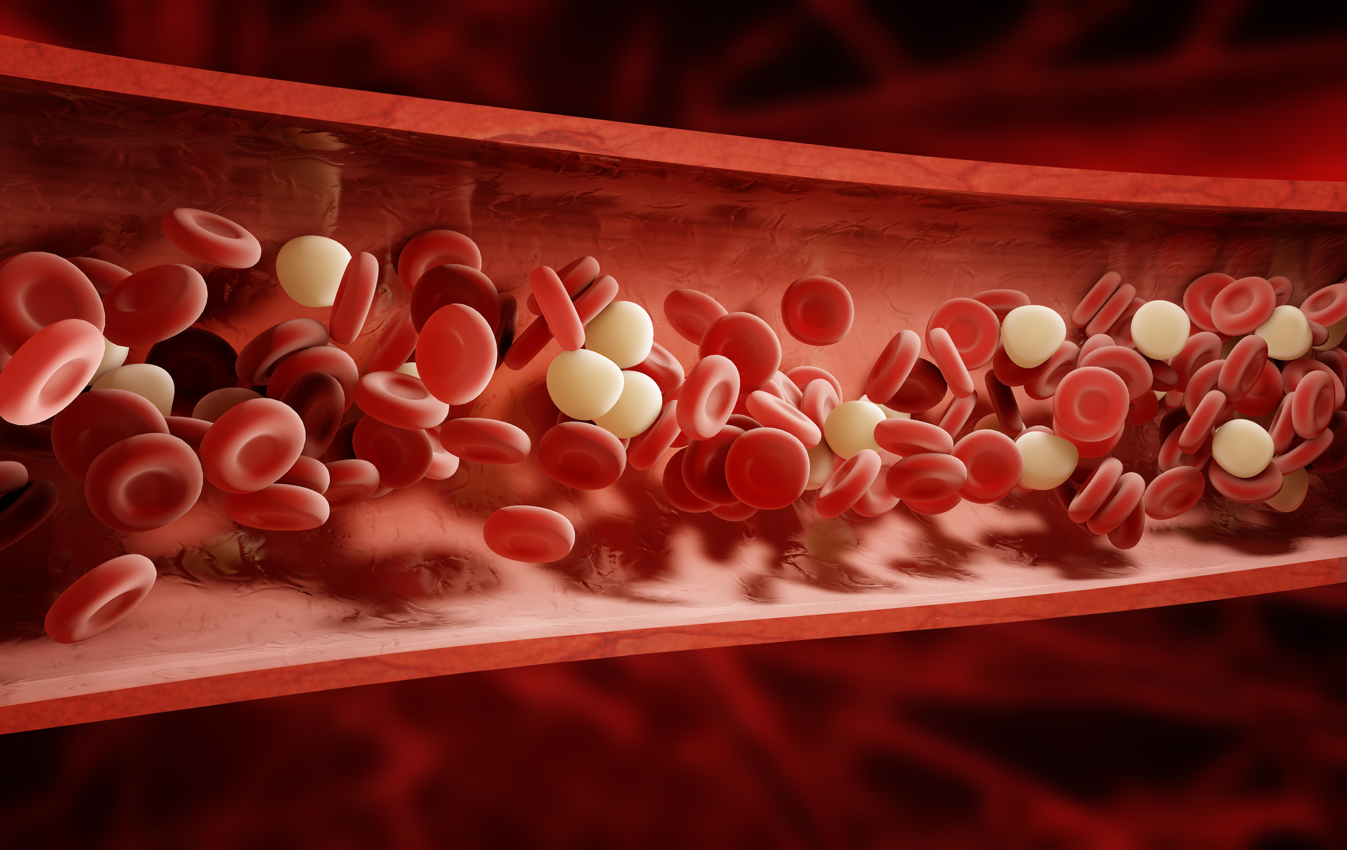
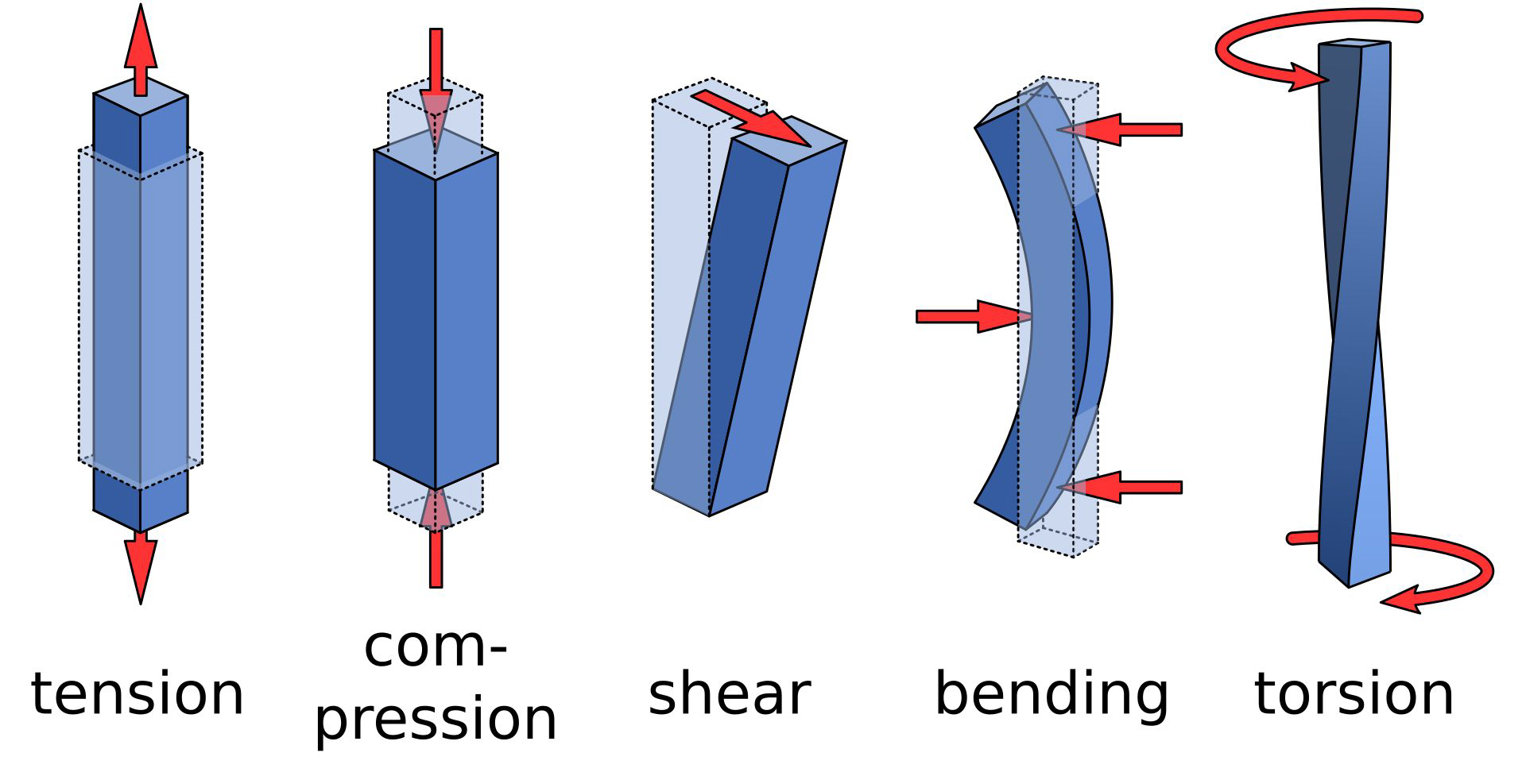
Material Properties – Mechanical
Biomaterials will experience many forces
Important for biomaterials to have similar mechanical properties to the tissue/organ it will be replacing
Examples:
                Properties for bone repair materials: Withstands body weight
                Properties for blood vessel materials: Withstands force of blood flow, and the narrowing and expansion of vessel

Slide 13
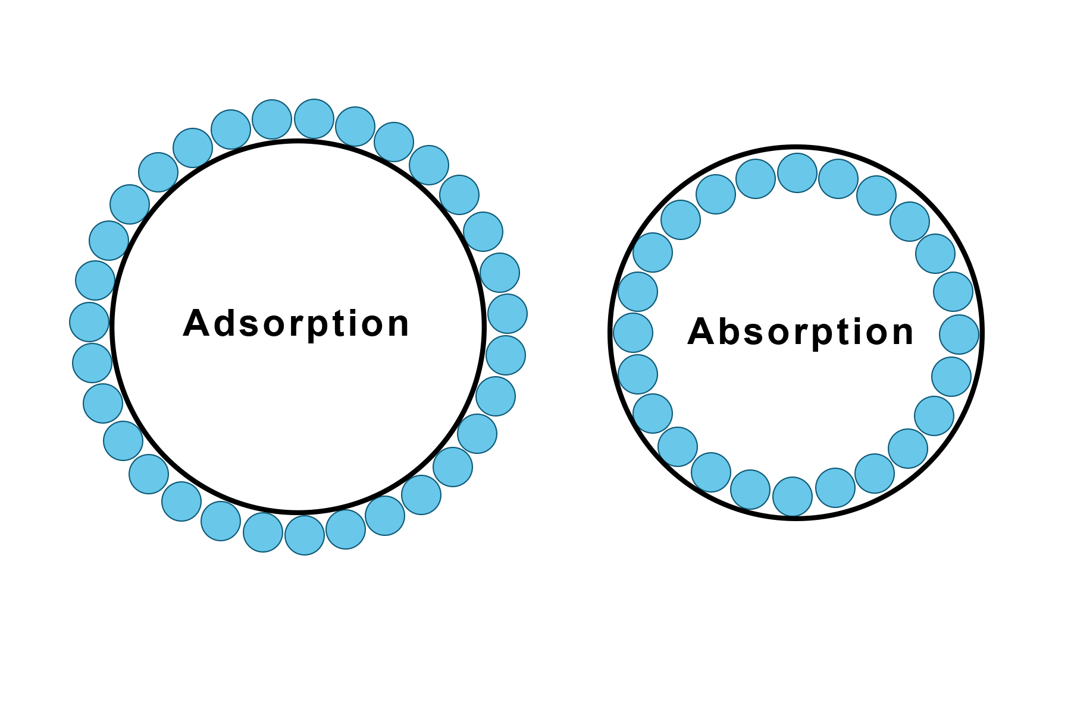
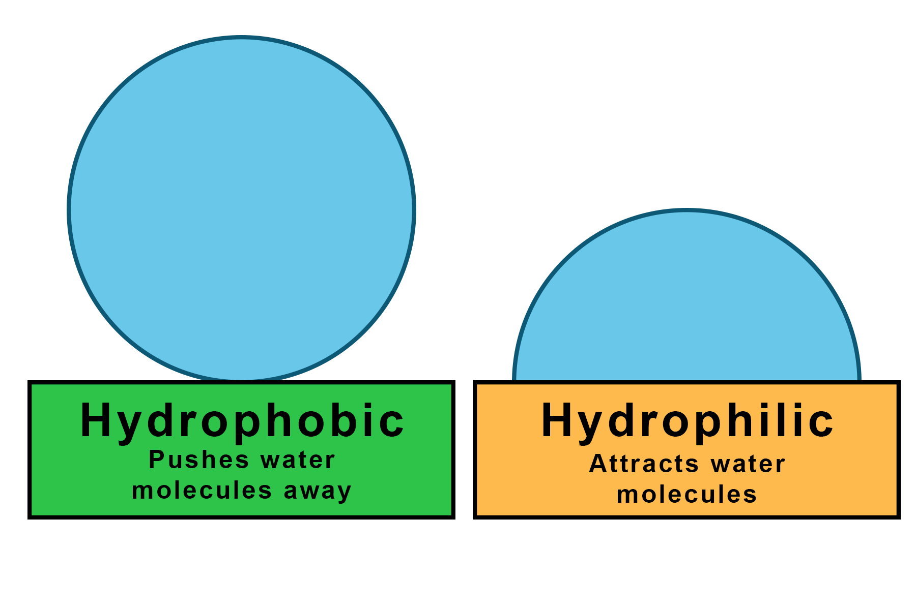
Material Properties – Surface
Surface Properties: special properties that exist only at the surface of a material
  Adsorption: ability of molecules to stick to the surface of a material
    Proteins attached to the material prior to implantation
    Surface coating allowing for proteins or cells to attach once implanted
  Hydrophobic: Water fearing/repelling surface
  Hydrophilic: Water loving surface
  Surface Roughness: Smoothness or roughness of a surface which can change cell and protein attachment to surface
  Surface Coatings: Coating added to the surface of a material to change its surface specific properties.
    Ex: can be used to alter roughness, hydrophobicity, protein adsorption, degradation, etc.
  Surface Degradation: previously described

Slide 14
Material Properties – Bulk
Bulk: Properties that exist throughout the entire material.
  Examples
    Mechanical properties
    Porosity
    Absorption
    Thermal
    Bulk degradation

Slide 15
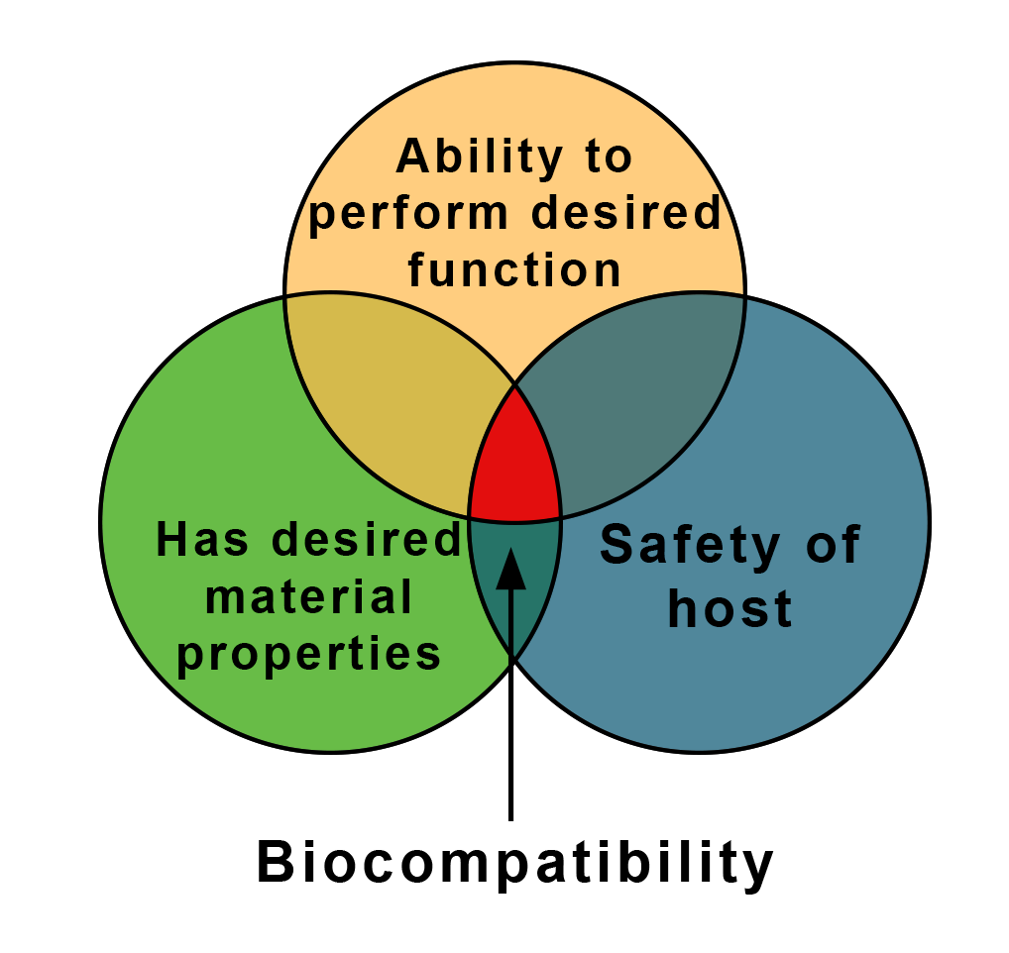
Material Properties – Biocompatibility
Biocompatibility: Ability of a material to cause a biological response once implanted
  Bio-: related to living organisms
  -Compatible: how well two things get along
Problems with biocompatibility:
    Immune rejection of material could cause inflammation, swelling, redness, or infection
    We want materials to be biocompatible to reduce unwanted immune reactions
Method for improving biocompatibility:
  Sterilization → reduces chance of virus/disease transfer, reduced infection risk
  Bioactive coatings → can help prevent negative biological responses
  Surface properties → reducing adsorption properties (limits bacterial adsorption)
  Incorporating antibacterials
  Using natural materials

Slide 16
Image Credits:
Slide 1: Alexander Steamaze/Shutterstock.com
Slide 2: Denis---S/Shutterstock.com, Davizro Photography/Shutterstock.com, Ivan_Shenets/Shutterstock.com, maradek/Shutterstock.com
Slide 4: Chzu/Shutterstock.com
Slide 5: Joaquin Corbalan P/Shutterstock.com
Slide 6: Vink Fan/Shutterstock.com, Meade/NIBIB
Slide 7: Sansanorth/Shutterstock.com
Slide 8: Okayanstvo/Shutterstock.com
Slide 9: Vectoressa/Shutterstock.com, Meade/NIBIB
Slide 10: Meade/NIBIB
Slide 11: Maria Eliza Moraes/Shutterstock.com
Slide 12: Vectoressa/Shutterstock.com, cosmin4000/iStock.com, MikeRun/Wikimedia Commons
Slide 13: Meade/NIBIB, Meade/NIBIB
Slide 14: Denis---S/Shutterstock.com
Slide 15: Meade/NIBIB

Slide 17
What are Biomaterials?

Slide 18
Biomaterials:
A synthetic or natural material that is used in a and intended to interact with .

Slide 19
Synthetic vs Natural
Synthetic: materials made through chemical reactions, producing a material with new properties (stainless steel, titanium, etc.)
Natural: materials found in nature/biologically derived (silk, collagen, gelatin, etc.)
Combination: material made of both synthetic and natural materials

Slide 20
Ceramics
Ceramics: A hard material made from , but non-metallic raw materials (clay, sand, etc.)
Medical Applications:
Synthetic or natural:
Can be synthetic or natural, or a combination of both
Source: Britannica Kids

Slide 21
Definition: “A substance characterized by its strength and ability to conduct heat and electricity”
Medical Applications: Electrodes for electronic devices, orthopedic fixation plates and screws, etc.
Natural or Synthetic:
Can be synthetic or natural
Source: Mining and Refining
Source: Britannica Kids

Slide 22
What are the three major types of biomaterials?

Slide 23
Polymers
Definition: Large molecules made from small repeating units.
  Poly = many
                = the repeating units within a polymer
Medical Applications: , knuckle replacements,
Source: Synthetic polymers are derived from petroleum oil
How are they made: synthetic polymers are created through chemical reactions
Synthetic or natural: Can be synthetic or natural, or a combination
Hydrogels: A type of polymer that swells in water and retains water within the structure without dissolving (used for soft tissue applications such as contract lenses)

Slide 24
Composites
Definition: Substances consisting of two or more (metals, polymers, ceramics, etc.)
Why use composites? Used to and often to optimize mechanical properties.
Medical Applications: Dental implants or orthopedics
Synthetic or natural: Can be synthetic, natural or a combination

Slide 25
Material Properties
Materials are often chosen for a medical application based on their
Examples:
  Load bearing bone/joint → need a material that can withstand the loading forces
  Soft tissue → need a soft material that can be infiltrated by cells

Slide 26
Material Properties – Degradation
Biodegradable: controlled loss of material (degradation) within the body following implantation/administration of the biomaterial.
  Example: Controlled drug release
Biomaterials for tissue engineering aim to support → new tissue forms while materials

Slide 27
Material Properties – Porosity
Porosity: Percentage of added throughout a material
Porosity affects mechanical properties and promotes favorable tissue responses.

Slide 28
Material Properties – Mechanical
Biomaterials will experience many
Important for biomaterials to have similar mechanical properties to the tissue/organ it will be replacing
Examples:
                Properties for bone repair materials: Withstands body weight
                Properties for blood vessel materials: Withstands force of blood flow, and the narrowing and expansion of vessel

Slide 29
Material Properties – Surface
Surface Properties: special properties that exist only at the surface of a material
  Adsorption: ability of molecules to stick to
    Proteins attached to the material prior to implantation
    Surface coating allowing for proteins or cells to attach once implanted
  Hydrophobic: Water surface
  Hydrophilic: Water surface
  Surface Roughness: Smoothness or roughness of a surface which can change cell and protein attachment to surface
  Surface Coatings: Coating added to the surface of a material to change its surface specific properties.
    Ex: can be used to alter roughness, hydrophobicity, protein adsorption, degradation, etc.
  Surface Degradation: previously described

Slide 30
Material Properties – Bulk
Bulk: Properties that exist
material.
  Examples
    Mechanical properties
    Porosity
    Absorption
    Bulk degradation

Slide 31
Material Properties – Biocompatibility
Biocompatibility: Ability of a material to cause a once implanted
  Bio-: related to living organisms
  -Compatible: how well two things get along
Problems with biocompatibility:
    Immune rejection of material could cause inflammation, swelling, redness, or infection
    We want materials to be biocompatible to reduce unwanted immune reactions
Method for improving biocompatibility:
      → reduces chance of virus/disease transfer, reduced infection risk
  Bioactive coatings → can help prevent negative biological responses
  → reducing adsorption properties (limits bacterial adsorption)
  Incorporating antibacterials
  Using natural materials

Slide 32
Image Credits:
Slide 1: Alexander Steamaze/Shutterstock.com
Slide 2: Denis---S/Shutterstock.com, Davizro Photography/Shutterstock.com, Ivan_Shenets/Shutterstock.com, maradek/Shutterstock.com
Slide 4: Chzu/Shutterstock.com
Slide 5: Joaquin Corbalan P/Shutterstock.com
Slide 6: Vink Fan/Shutterstock.com, Meade/NIBIB
Slide 7: Sansanorth/Shutterstock.com
Slide 8: Okayanstvo/Shutterstock.com
Slide 9: Vectoressa/Shutterstock.com, Meade/NIBIB
Slide 10: Meade/NIBIB
Slide 11: Maria Eliza Moraes/Shutterstock.com
Slide 12: Vectoressa/Shutterstock.com, cosmin4000/iStock.com, MikeRun/Wikimedia Commons
Slide 13: Meade/NIBIB, Meade/NIBIB
Slide 14: Denis---S/Shutterstock.com
Slide 15: Meade/NIBIB
Slide 1: Alexander Steamaze/Shutterstock.com
Slide 2: Denis---S/Shutterstock.com, Davizro Photography/Shutterstock.com, Ivan_Shenets/Shutterstock.com, maradek/Shutterstock.com
Slide 4: Chzu/Shutterstock.com
Slide 5: Joaquin Corbalan P/Shutterstock.com
Slide 6: Vink Fan/Shutterstock.com, Meade/NIBIB
Slide 7: Sansanorth/Shutterstock.com
Slide 8: Okayanstvo/Shutterstock.com
Slide 9: Vectoressa/Shutterstock.com, Meade/NIBIB
Slide 10: Meade/NIBIB
Slide 11: Maria Eliza Moraes/Shutterstock.com
Slide 12: Vectoressa/Shutterstock.com, cosmin4000/iStock.com, MikeRun/Wikimedia Commons
Slide 13: Meade/NIBIB, Meade/NIBIB
Slide 14: Denis---S/Shutterstock.com
Slide 15: Meade/NIBIB

Slide 33
Biomaterials
Quiz Game

Slide 34
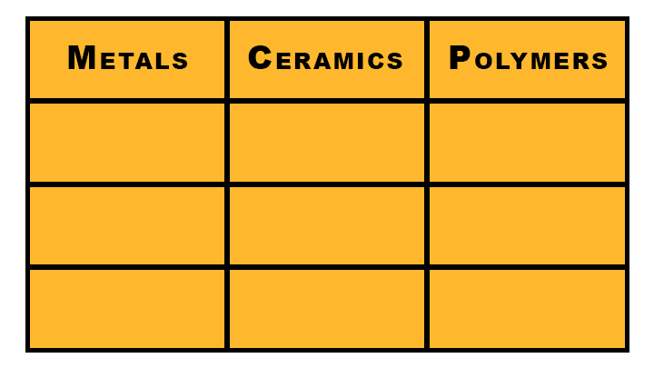
100
100
100
200
200
200
300
300
300

Slide 35

Metals 100
What are three
medical applications
of metals?
Back to Home

Slide 36
Metals 200
What is one advantage and one disadvantage
of metal biomaterials for medical applications?
Back to Home

Slide 37
Metals 300
Where are metals for biomaterials sourced?
Back to Home

Slide 38
Ceramics 100
What are three medical applications for
ceramic biomaterials
Back to Home

Slide 39
Ceramics 200
What is one advantage and one disadvantage of ceramic biomaterials for medical applications?
Back to Home

Slide 40
Ceramics 300
What tissue type are ceramic biomaterials most commonly used to replace and why?
Back to Home

Slide 41
Polymers 100
What is the building block/repeating unit of a polymer?
Back to Home

Slide 42
Polymers 200
What are three
medical applications of polymer biomaterials?
Back to Home

Slide 43
Polymers 300
What is a hydrogel?
Back to Home

Slide 44
Answers
Back to Home

Slide 45
*Other answers may
also be correct
Metals 100
Answer:
Hip replacement, dental implants, bone screws, bone plates, etc.
Back to Home

Slide 46
*Other answers may
also be correct
Metals 200
Answer:
Advantages: Mechanical properties, Resistant to fatigue degradation
Disadvantages: Corrodes, Metal Toxicity
Back to Home

Slide 47
Metals 300
Answer:
Mining and Refining
Back to Home

Slide 48
*Other answers may
also be correct
Ceramics 100
Answer:
Dental implants, Drug delivery, Joint replacement, Load-bearing
components, etc.
Back to Home

Slide 49
*Other answers may
also be correct
Ceramics 200
Answer:
Advantages: Biocompatibility, Non-corrosive, Mechanical properties
Disadvantages: Brittle, Slow degradation, Difficult to make
Back to Home

Slide 50
Ceramics 300
Answer:
Bone, Because of the similarities in structure
Back to Home

Slide 51
Polymers 100
Answer:
Mer
Back to Home

Slide 52
*Other answers may
also be correct
Polymers 200
Answer:
Drug delivery, Medical Devices, Anti-cancer therapy, Hydrogels, Artificial organs, etc.
Back to Home

Slide 53
Polymers 300
Answer:
A polymer that swells in water and retains water within the structure without dissolving
Back to Home

