Slide 1
Lesson Plan 1
DNA and Mutations

Slide 2
Teacher’s Notes

Slide 3
Slides to Present to Students

Slide 4
What are you? How do you change?
Genes and Mutations

Slide 5

Who are you?
Personality
Some of these you cannot control!
Behavior
Culture
Physical Traits

Slide 6
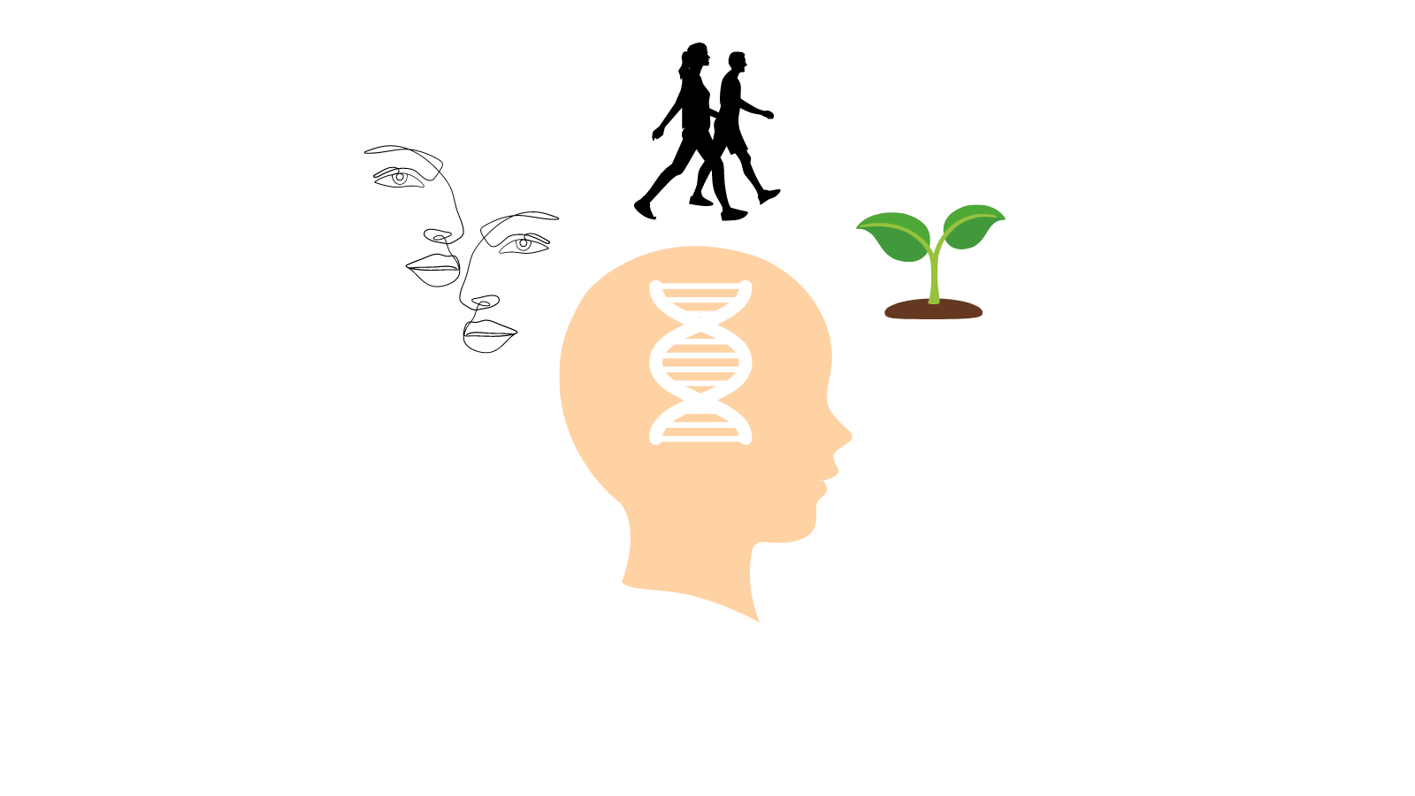
What determines the things you cannot control?
Genes!
Genes are molecules in every cell that act like recipes
They tell your cells how to behave by coding for proteins.
Genes determine how we look, move and grow
You get your genes from your parents.

Slide 7
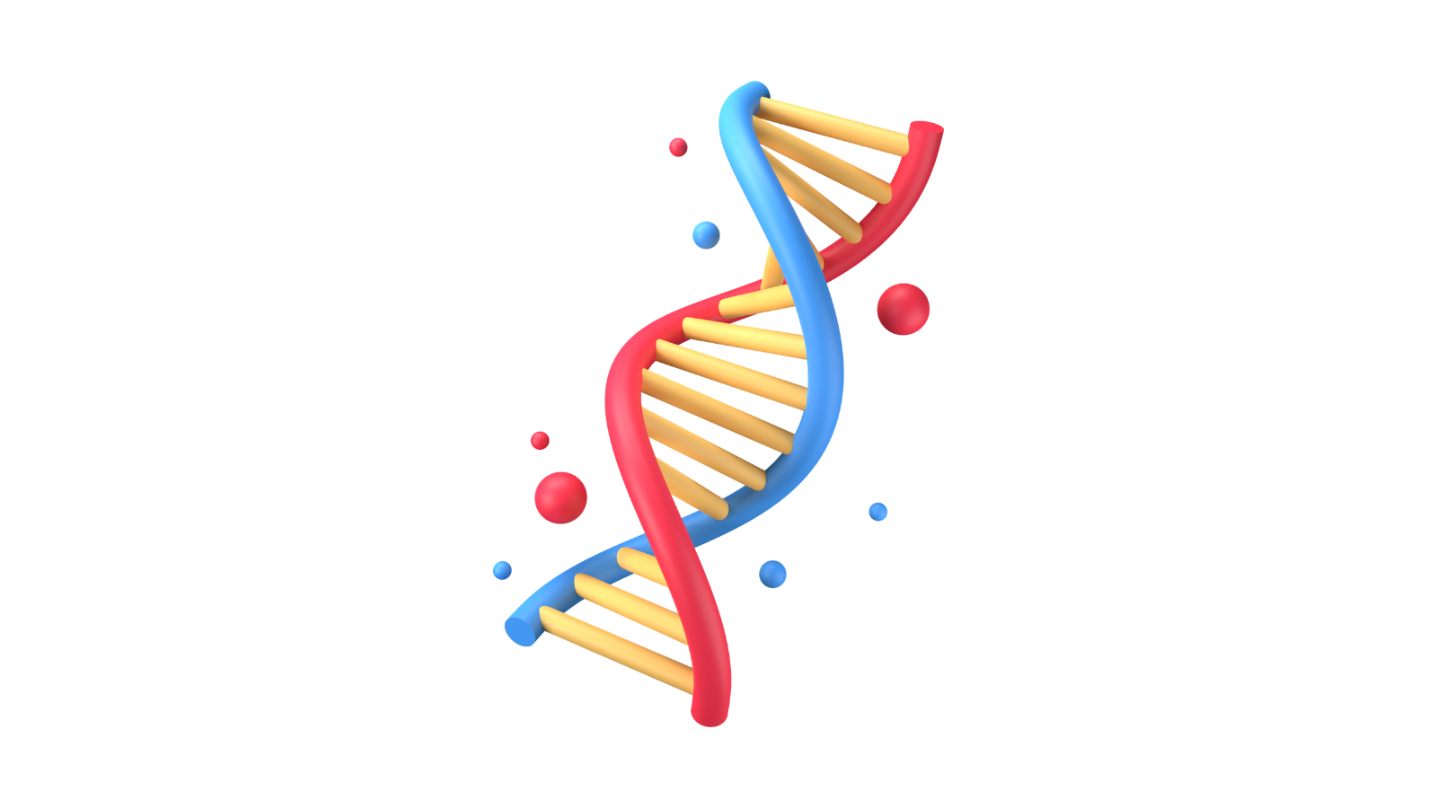
What are your genes made of?
DNA (Deoxyribonucleic Acid)
DNA holds your specific code for every part of your body
It is the collection of recipe books
A gene is made of a long strand of DNA
There are about 25,000 genes in your DNA.

Slide 8
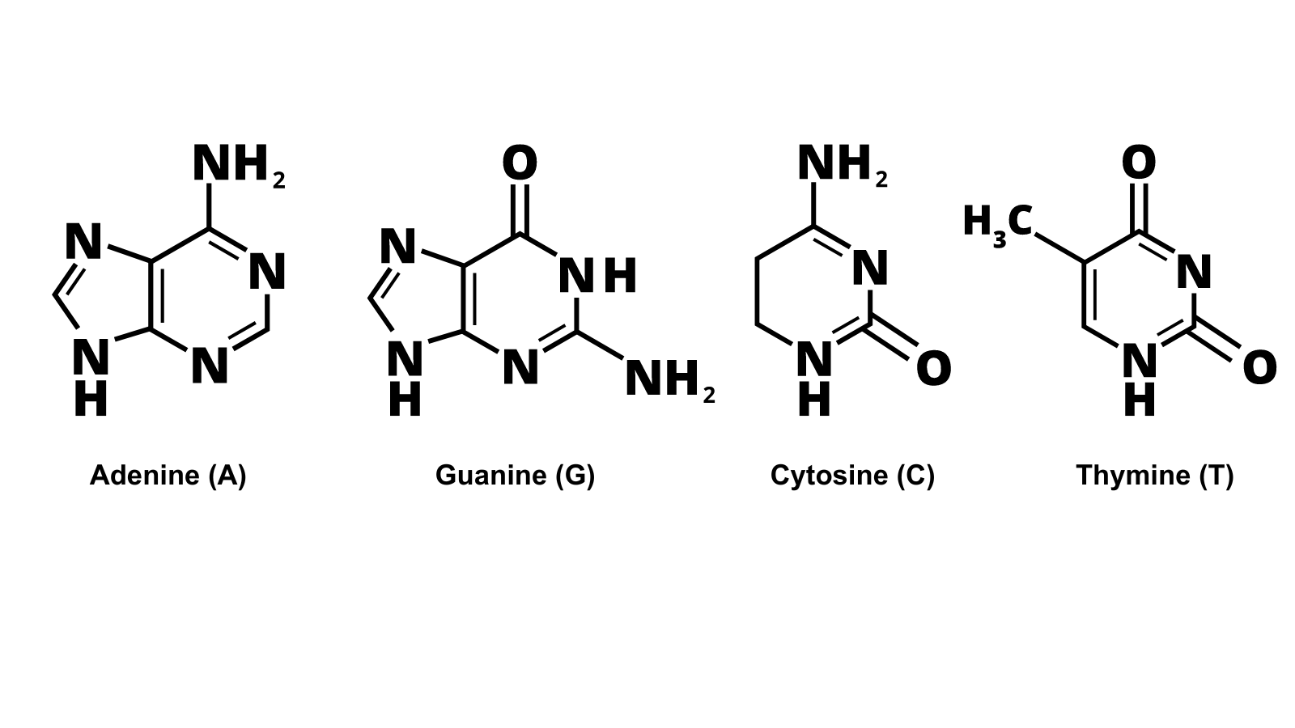
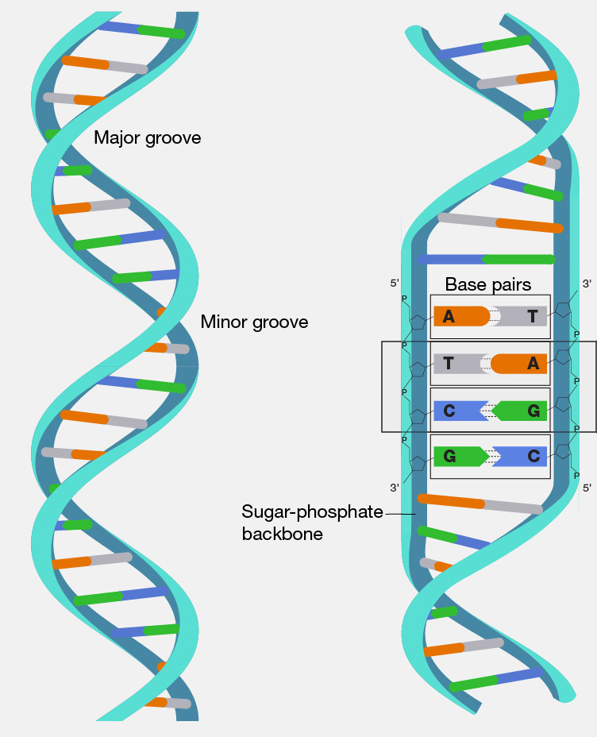
What is DNA made of?
Nucleotides!
What they do?
They code for your proteins that help your body do things.
Even small changes in the order of these nucleotides can make some big changes!

Slide 9
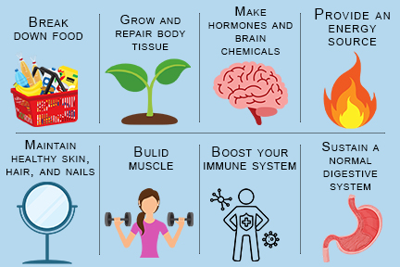
What do these proteins do? They make you!

Slide 10
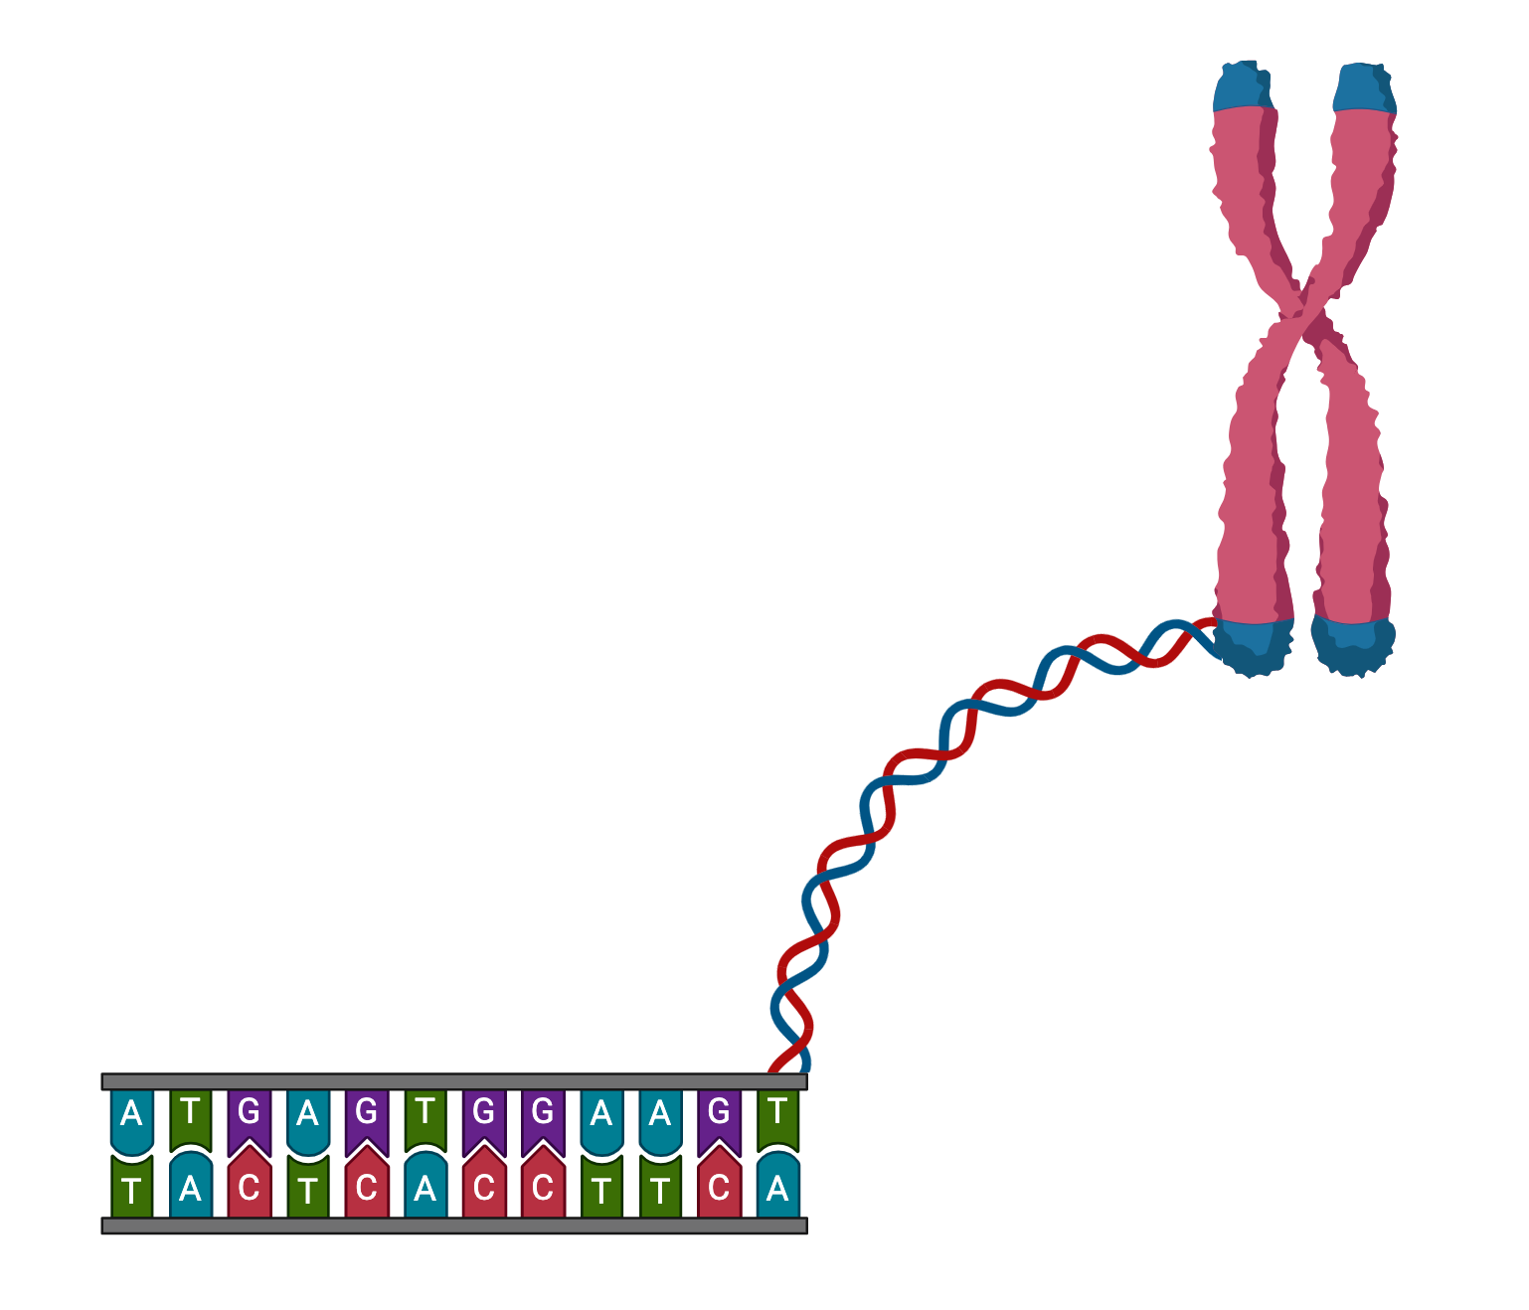
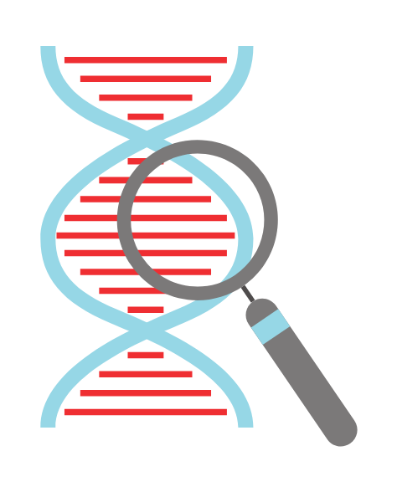
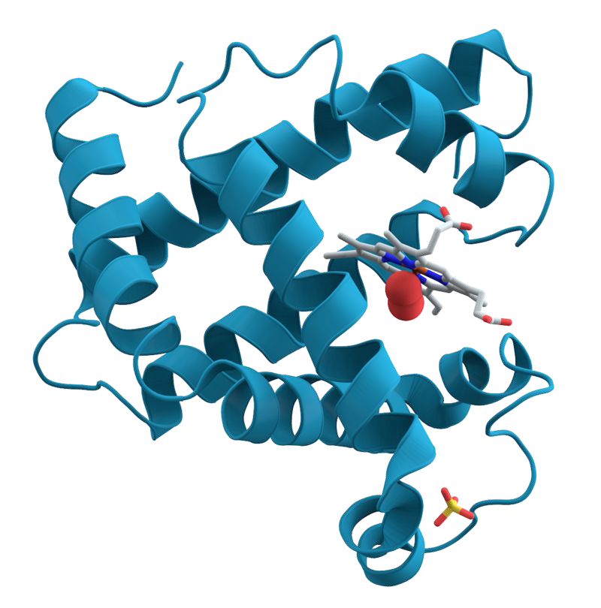
A little recap
Nucleotides → DNA → Genes → Proteins → YOU
Chromosome
A with T
C with G

Slide 11

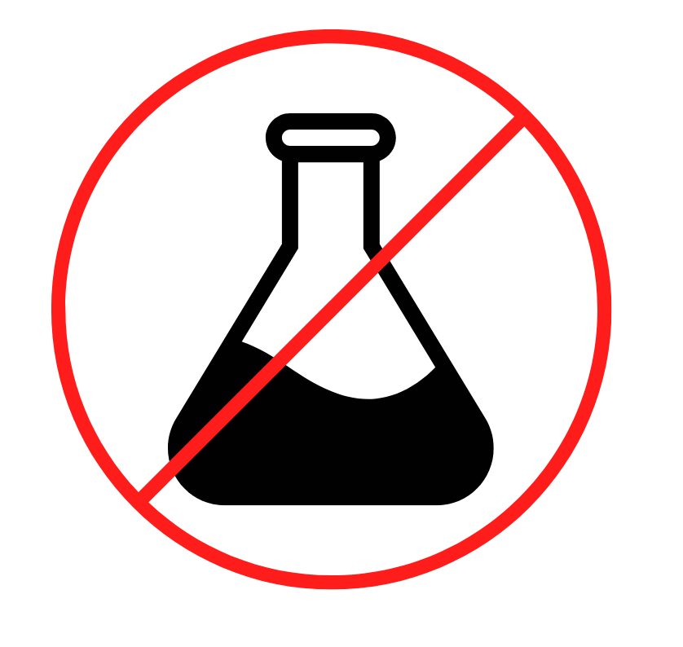
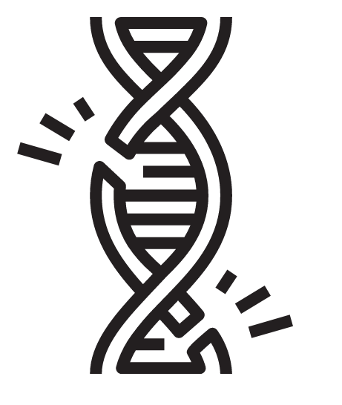
Changes to our DNA - MUTATIONS
Cause of mutations
A. Exposure to toxic substances
Radiation: UV rays, x-rays
Chemicals: PCBs, DDTs
B. Mistakes During cell reproduction
C. THEY CAN HAPPEN AT RANDOM

Slide 12
What can mutations do?
Negative Effects- Change in DNA sequence leads to a misfunctioning protein = DISORDER
NO Effect- JUNK DNA- does not code for anything
Positive Effects- promotes characteristics that allow better survival =EVOLUTION

Slide 13
What do mutations look like?
Substitution- Substituting a base
ATCAGCT= ATGAGCT
Deletion-Deleting a base
ATCAGCT =ACAGC
Addition- Adding a base
ATCAGCT= ATCCAGGCT
Inversion- Flipping around a sequence of 3 Bases
ATCAGCT= ATGACCT

Slide 14
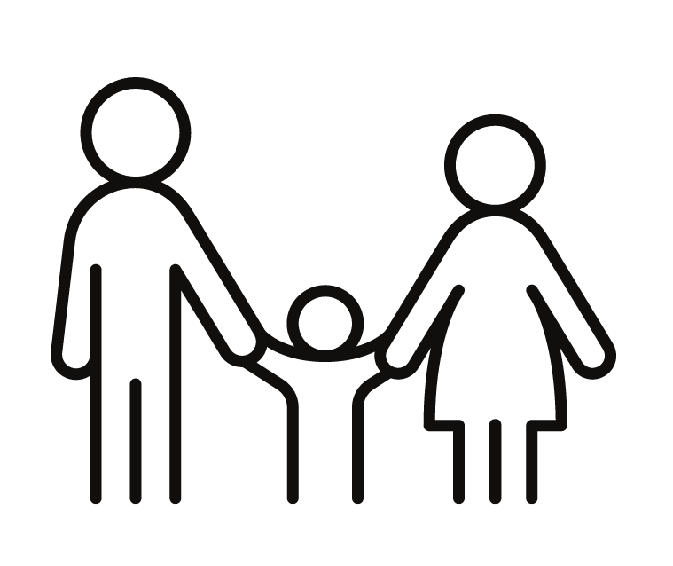
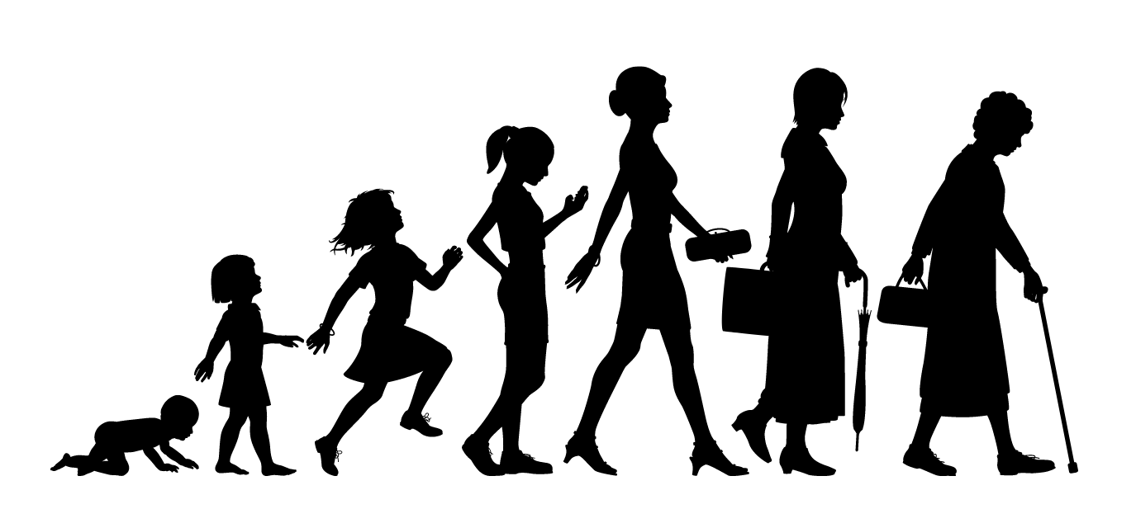
When do mutations happen?
Some happen before you are born → your parents pass them down
Germline Mutations
Others happen during the course of your life. They happen randomly and can’t be passed down to future generations.
Somatic Mutations

Slide 15
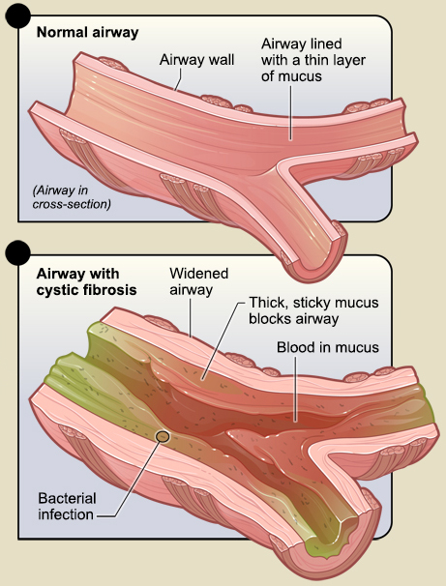
Cystic Fibrosis
Caused by mutations in the CFTR gene
Thick mucus in lungs and digestive tract
Caused by germline mutations

Slide 16
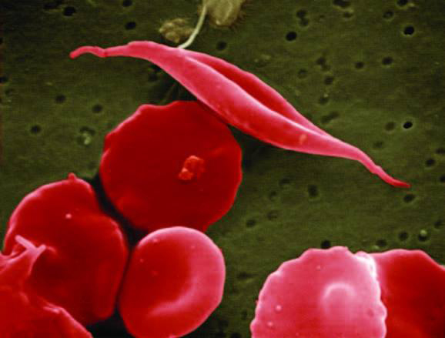
Sickle Cell Anemia
Caused by mutation in the HBB gene
Red blood cells become crescent-shaped
Caused by germline mutations

Slide 17
Huntington's Disease
Caused by mutations in the HTT gene
Affects the brain, causing movement and cognitive issues
Caused by germline mutations

Slide 18
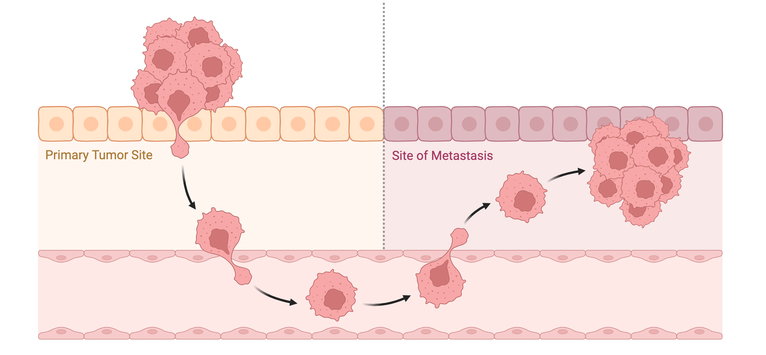
Cancer
Group of diseases where cells grow uncontrollably
These abnormal cells can invade other parts of the body
Mutations can turn a normal cell into a cancerous one
Mutations that promote cell growth or prevent cell death can lead to cancer
Can be caused by germline or somatic mutations

Slide 19
Image Credits:
Slide 5: canva.com
Slide 6: canva.com
Slide 7: canva.com
Slide 4: canva.com
Slide 8: canva.com, biorender.com
Slide 9: canva.com
Slide 10: biorender.com, canva.com
Slide 11: canva.com
Slide 14: canva.com
Slide 15: NIH/NHLBI
Slide 16: NIH/NHLBI
Slide 17: Pepermpron/Shutterstock.com
Slide 18: biorender.com

Slide 20
Lesson Plan 2: CRISPR

Slide 21
Teacher’s Notes

Slide 22
Slides to Present to Students

Slide 23
Let’s Review!
What do you remember about DNA, genes, and mutations?

Slide 24
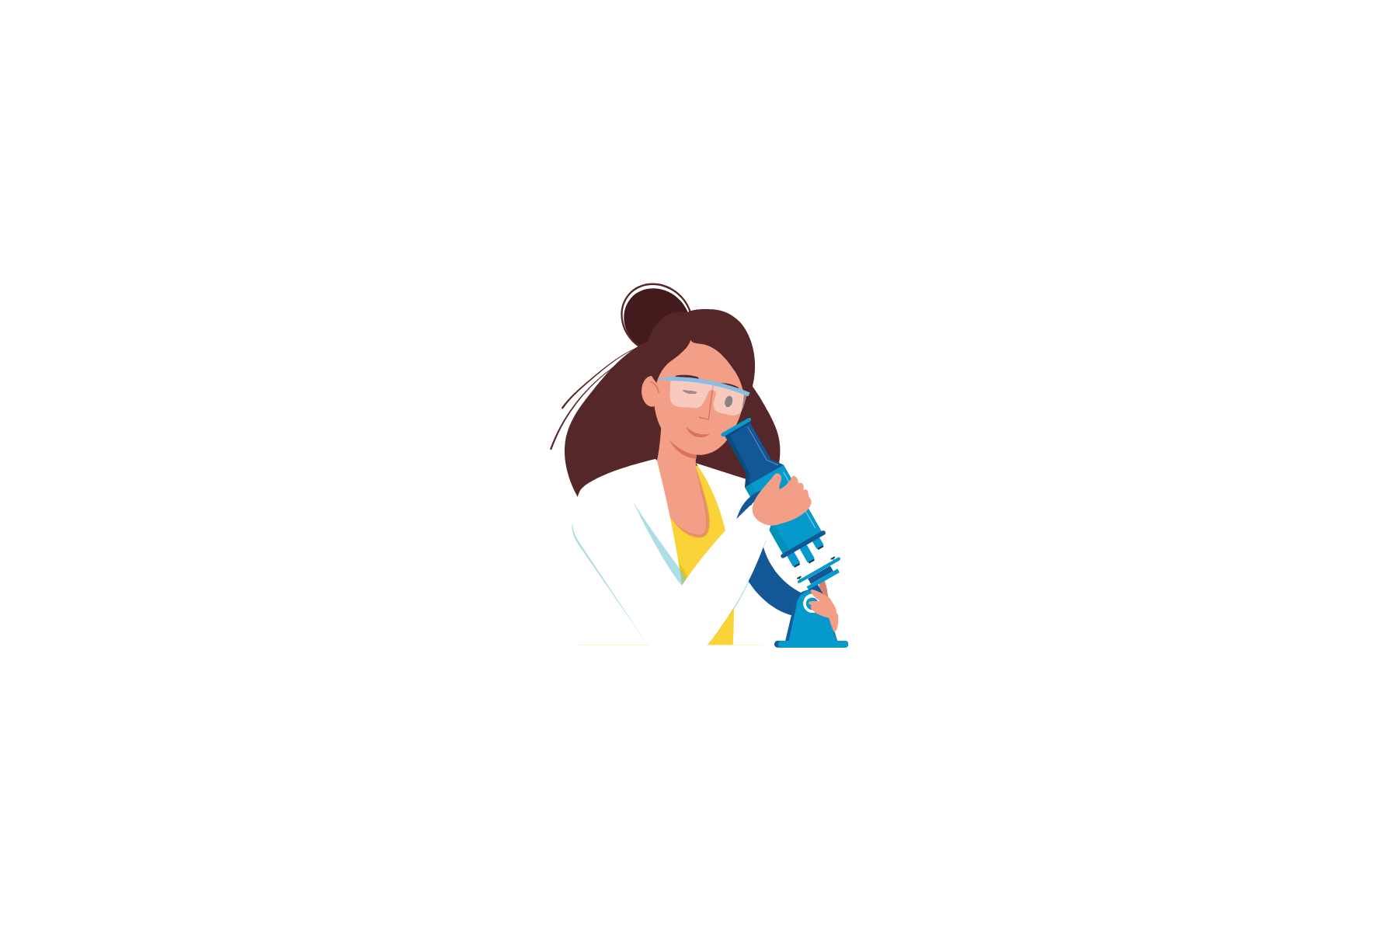
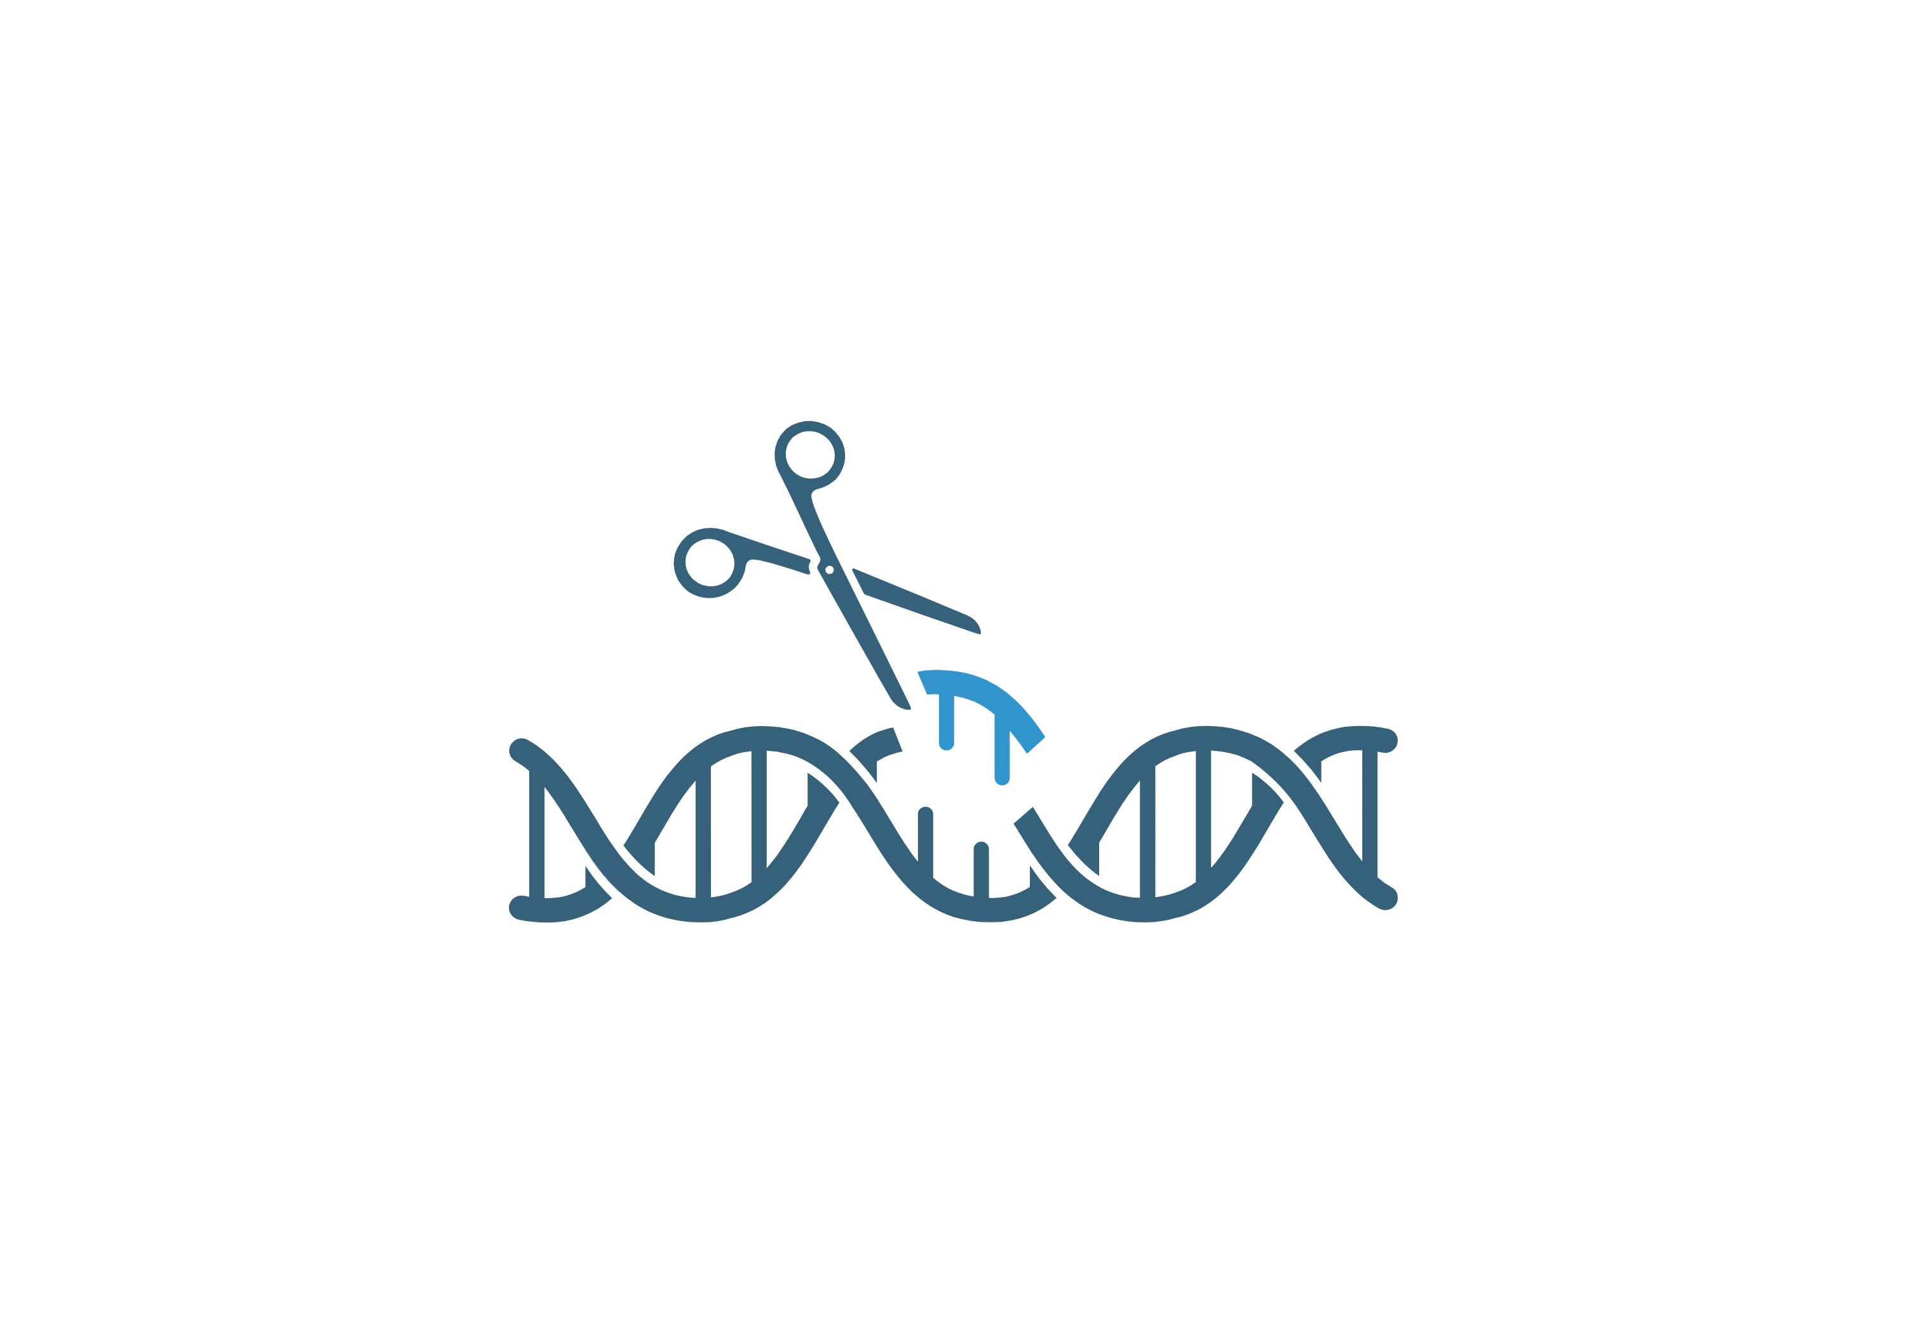
Now, let’s talk about one important tool scientists use: CRISPR

Slide 25
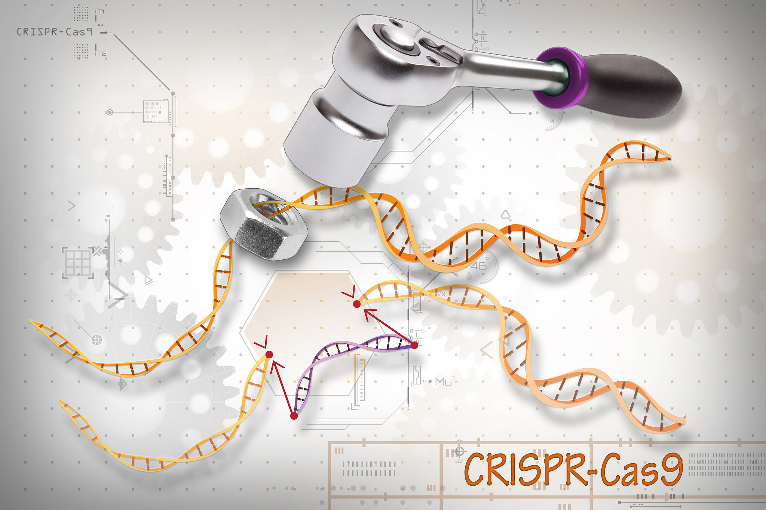
What does CRISPR stand for?
Clustered
Regularly
Interspaced Short
Palindromic Repeats

Slide 26
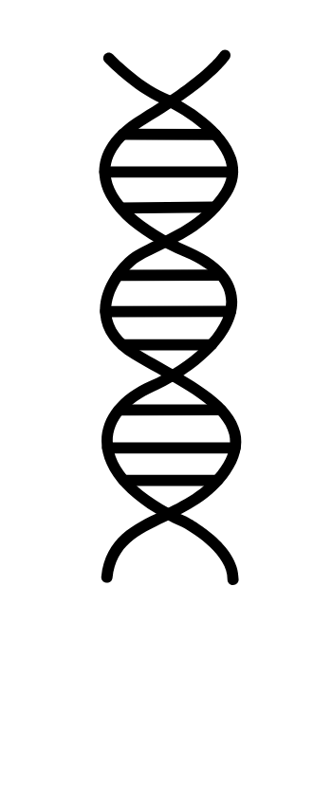
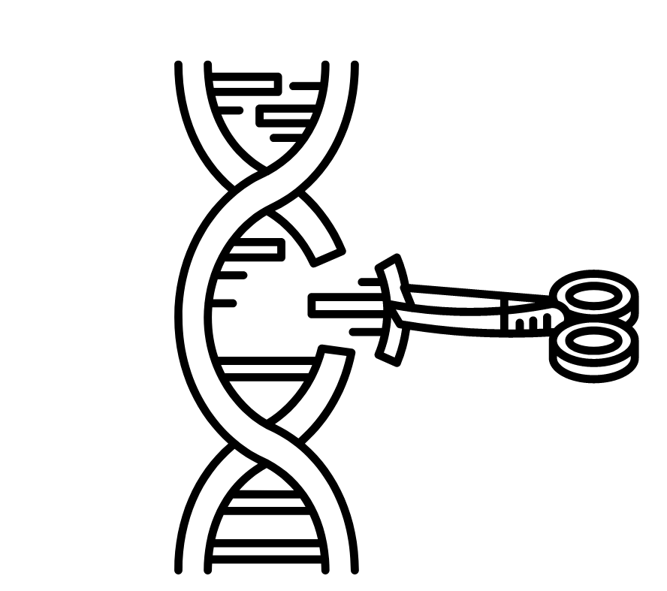
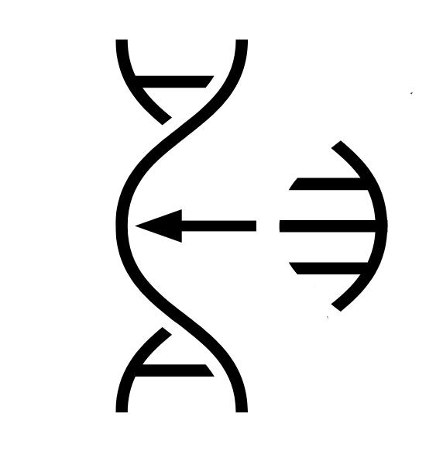


What is CRISPR used for?
→ CRISPR is a tool for editing genes in living organisms. It is like the “cut and paste” used on DNA. It can be used to simply cut out sections of DNA or it can replace the removed section.
CUT
PASTE
NEW DNA

Slide 27


Let’s go more in depth!
CRISPR uses two important helpers to complete the process.
.
CRISPR PROCESS
Cas9 PROTEIN
GUIDE RNA

Slide 28
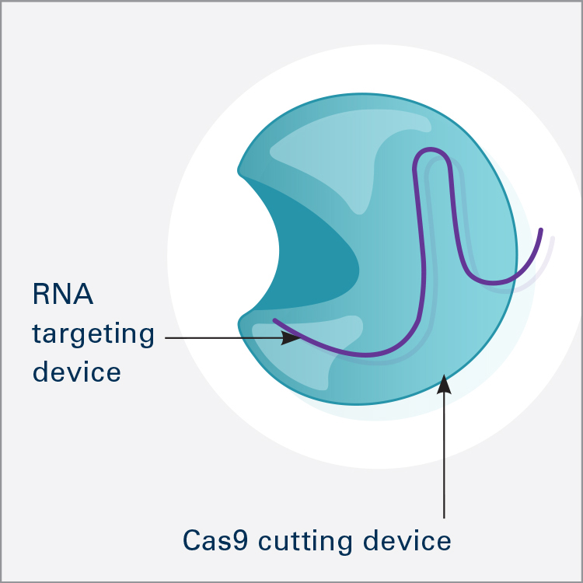
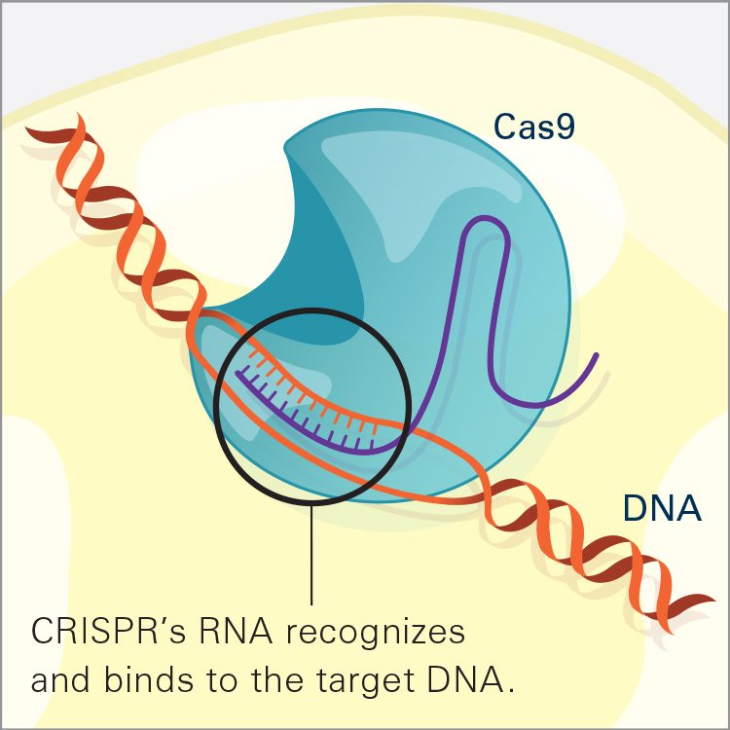
CRISPR’s Helpers
Cas9 Protein
Guide RNA
This special protein does the cutting of the DNA sequence!
The guide RNA tells Cas9 which DNA sequence to specifically cut. It is like a CRISPR map!

Slide 29
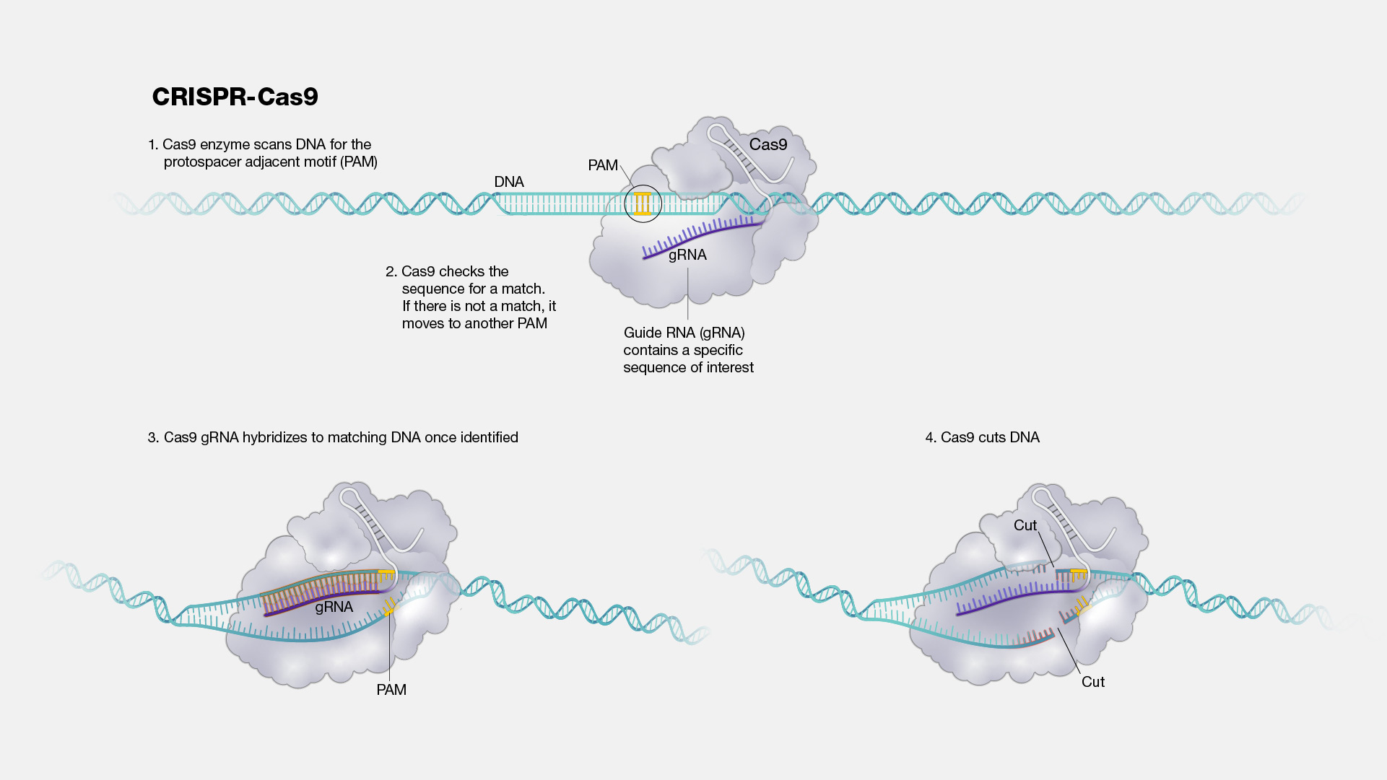

Slide 30
CASE STUDY: CRISPR for Treating Sickle Cell Anemia
Red blood cells carry oxygen to all parts in our bodies.
But for people that have sickle cell anemia, their red blood cells are shaped differently, almost like a banana. This can cause them pain, discomfort, tiredness, and other serious health problems.

Slide 31
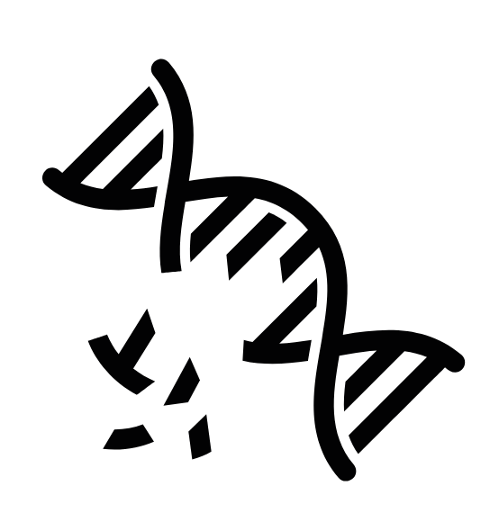

Why does Sickle Cell Anemia happen?
It can happen because of a “typo” in the DNA sequence.
The U.S. Food & Drug Administration approved the first gene therapies to treat Sickle Cell disease in December 2023.

Slide 32

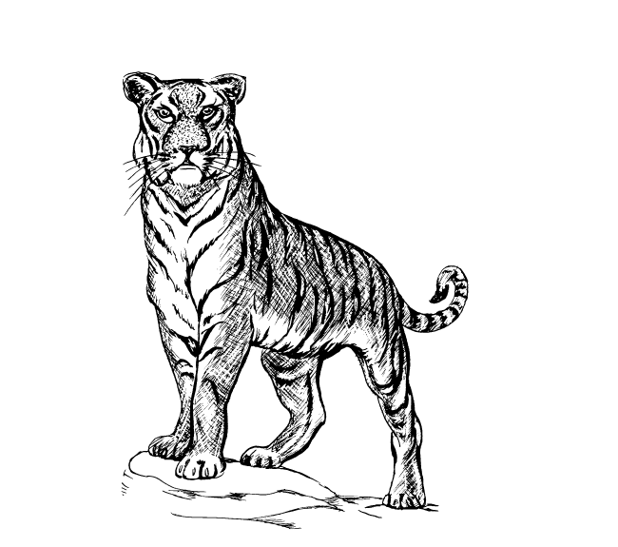
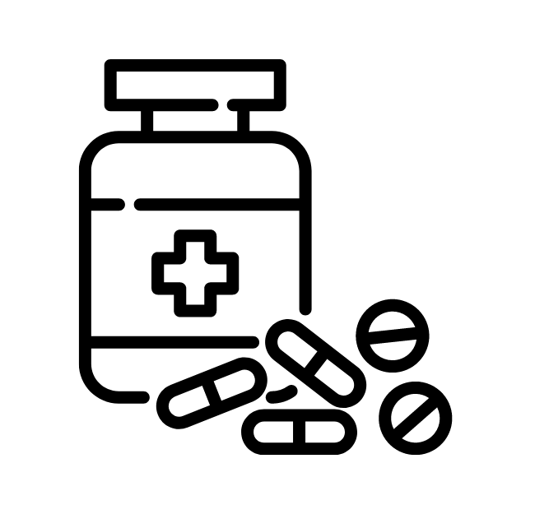
How else can we use CRISPR?
Every living thing has genes, including plants! If there is a mutation that is vital for life, we can use CRISPR to help fix and improve the situation.
CROPS
ENDANGERED ANIMALS
MEDICINE

Slide 33
Image Credits:
Slide 5: canva.com
Slide 6: NIH/NHGRI
Slide 7: canva.com
Slide 8: canva.com
Slide 9: canva.com, NIH/NIGMS
Slide 10: NIH/NHGRI
Slide 11: NIH/NHLBI
Slide 12: canva.com
Slide 13: canva.com

