Slide 1
EXPLORING BIOMEDICAL ENGINEERING
& SURGICAL ROBOTS
Biomedical engineering adapted for middle school
(BEAMS)

Slide 2
Who is an engineer?
An engineer is a person who designs and builds solutions to solve problems

Slide 3
What is biomedical engineering?
Biomedical engineers solve problems related to human health and medicine.

Slide 4
How do engineers create solutions?
Engineer Design Process
Identify the problem
Plan/brainstorm a solution
Design and build a prototype
Test and Improve, improve, improve
Present solutions

Slide 5
Example solution: surgical robots

Slide 6
1. Identify the problem
Research
Ask experts

Slide 7
2. Plan/Brainstorm
Criteria: Requirements Constraints: Limits

Slide 8
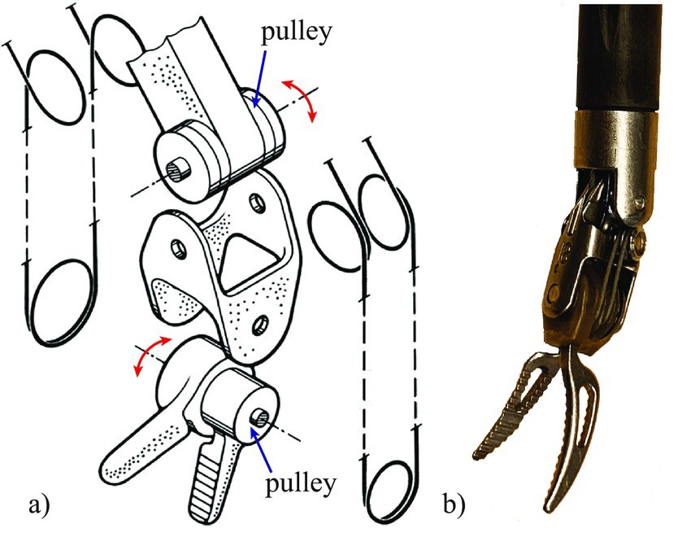
Example: Da Vinci Robot
Da Vinci Robot used to make origami crane the size of a penny

Slide 9
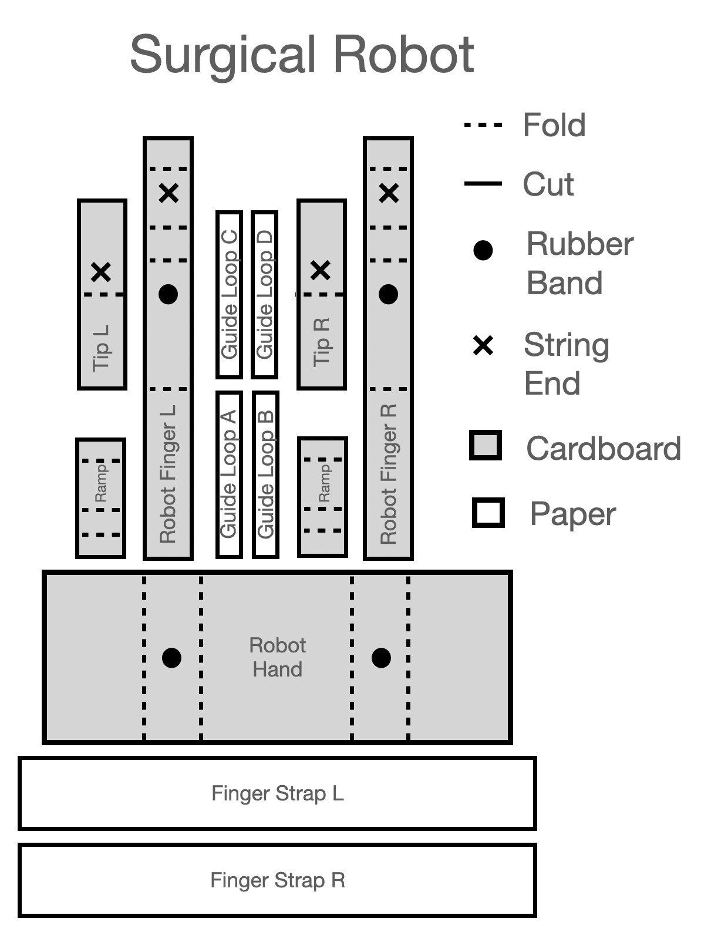
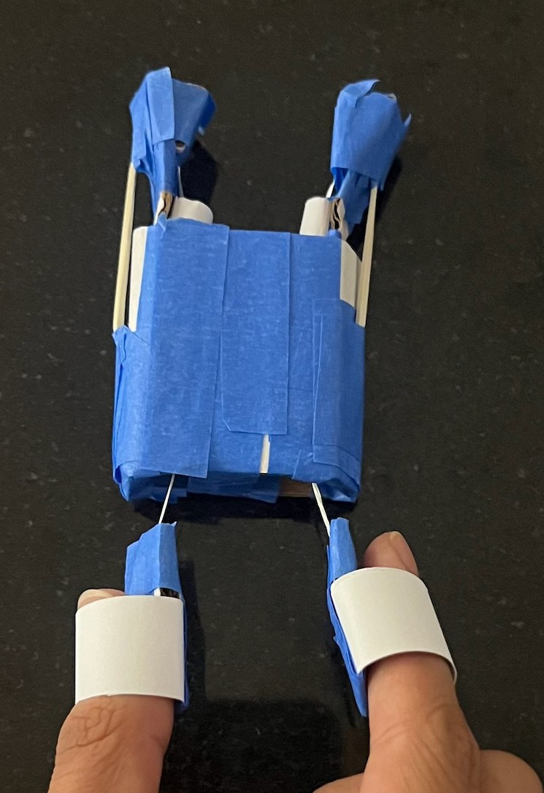
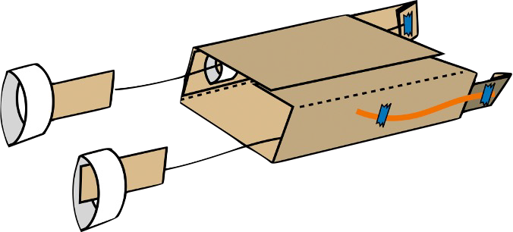
3. Design and build a prototype

Slide 10
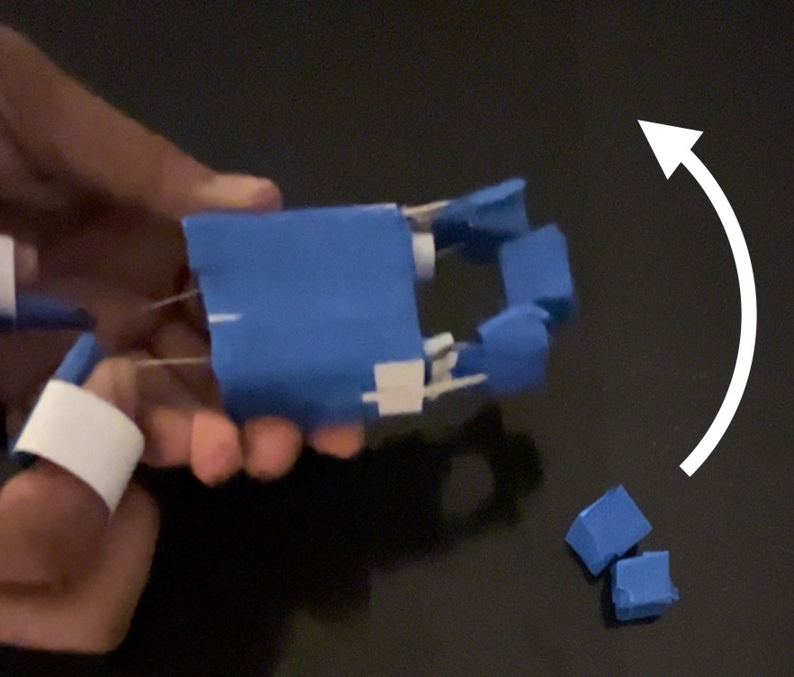
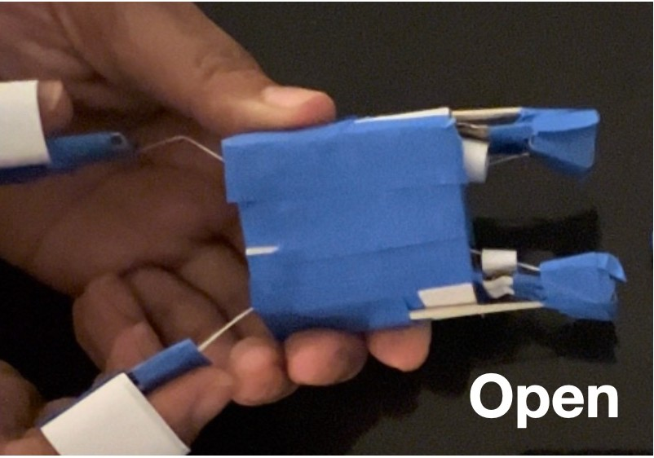
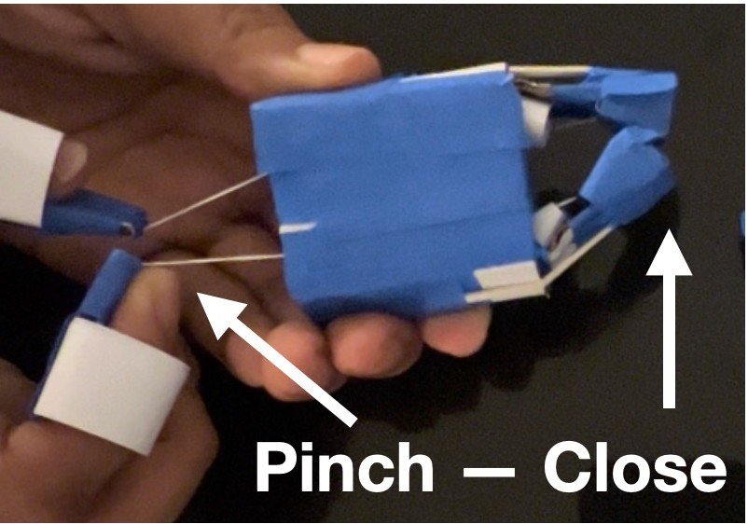
4. Test and improve, improve,
improve

Slide 11
5. Present solutions
Congratulations engineer on building a prototype!
It’s your turn to share with the class.

Slide 12
Image Credits
Slide 1: MS Office
Slide 2: MS Office
Slide 3: MS Office
Slide 5: Adobe Stock
Slide 6: Adobe Stock, MS Office
Slide 7: MS Office, Canva
Slide 8: Shutterstock.com/MAD.vertise, 2020 Culmone et al. Creative Commons Attribution License
Slide 9: Kiara Quinn
Slide 10: Kiara Quinn

